Slide 1

Red Hat OpenShift: The platform for a
hybrid cloud world
Driving enterprise transformation
Presenter’s Name
Title
Presenter’s Name
Title
Notes:
Thanks for meeting with us today. I want to kick things off by showing you something that is utterly untrue…

Slide 2
ABOUT THIS PRESENTATION
WHO IS THE TARGET AUDIENCE
Decision makers interested in containers and Kubernetes
Who want to understand what OpenShift can do for them
Represent app dev, IT operations, and architecture teams
WHAT IS THE OVERALL OBJECTIVE
Provide an overview of OpenShift
Explain our value prop and differentiation
Generate interest for a more in-depth demo or workshop
HOW DOES IT FIT WITH OTHER CONTENT
Overview of Red Hat OpenShift
OpenShift Technical Overview
OpenShift Roadmap and more ...
Notes:
This presentation is best used when a customer/prospect is generally interested in containers, Kubernetes and wants to get an overview of what OpenShift is all about. The deck is fully scripted but requires some technical knowledge. It is best suited for delivery by SAs or SSPs.
Please check the Appendix which has additional content modules about containers, OpenShift momentum, community & partner information and lots more.
To customize this deck, create a copy first before moving slides around.

Slide 3


No CEO would ever say:
“We didn’t ship our product on time and missed revenue projections, but it’s okay because we migrated to the cloud.”
Notes:
No CEO would ever say: We didn’t ship our product on time and missed revenue projections, but it’s okay because we migrated to the cloud.

Slide 4
So, why do so many organizations operate like they would?
Notes:
So why do so many organizations operate like they would?
We know that cloud migration is one thing, but it’s not everything. The cloud is table stakes.
And the truth is, you’re probably already in the cloud - or in multiple clouds.
In fact, I wonder if this looks familiar.

Slide 5






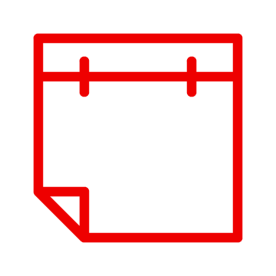

Reality of enterprise IT environments
A mixed infrastructure environment
63%
of organizations are already using hybrid cloud today.¹
54%
of those not using hybrid cloud today plan to within 24 months.¹
Source: Red Hat detail. “The State of Enterprise Open Source,” Feb. 2021.
Notes:
If you are like most of our customers, you have a wild mix of new and old when it comes to the infrastructure you use to run your organization.
Where are you trying to run these applications that run your business? In the cloud? On-premises? On bare metal servers? In virtual machines?
The reality is that you are probably already using multiple clouds in addition to your private cloud or datacenter. And, very likely, on bare metal and at the Edge.
So your infrastructure platforms are already hybrid.
What about your applications?

Slide 6






Reality of enterprise IT environments
Diverse app portfolios
Serverless
Analytics
.Net
AI/ML
ISV
Cloud-native and microservices
Java™
Notes:
You probably also have a wide mix of new and old when it comes to the applications that you need to run your organization.
Most large enterprises have huge existing app portfolios that are built with traditional architectures (monolithic or n-tier, ESBs, etc.) and traditional languages (Java or .NET or maybe C++ or even mainframe apps).
Supporting stateful and stateless workloads.
In addition, every enterprise is building new apps or modernizing some of those existing apps on new architectures (microservices, APIs) with newer languages/frameworks (Spring, Quarkus, Node.js, etc.).
And many of them are moving now to integrate more intelligence and newer models into their apps (analytics, AI/ML, event driven architectures/serverless/functions, etc.).
What do you have in your application portfolio?
What challenges do you struggle with in terms of serving the business with that application portfolio?

Slide 7




Reality of enterprise IT environments
Development, IT processes, and skills
People and
policies
The right
skills
DevOps
Developer tools
Notes:
What about your development processes and methodologies?
In addition to continuing to support your applications developed with a waterfall methodology, you now want to implement CI/CD and a DevOps methodology.
And you need to provide the mix of skills that you need to support these varying methodologies. Development teams must keep pace and identify new ways to build and deploy applications faster, so skill sets need to stay current and relevant. People are your most important asset and they need to adapt over time too.
But what if you can’t find and retain the right people with the right skills? Do you have who you need to run your platform or do you need to find those skills outside of your organization?
The “born in the cloud” companies have changed the world by showing what they can do with these new approaches.

Slide 8


Reality of enterprise IT environments
Mixed infrastructure environments, diverse app portfolios, & limited automation
Infrastructure
Applications
Development, IT processes,
and skills
Bare metal
Virtualization
Edge
AI/ML
Analytics
Serverless
Developer
tools
Pipeline and
processes
People and
policies
Private cloud
Public cloud
Cloud-native and microservices
Java™
.Net
The right
skills
ISV
Source: Red Hat detail. “The State of Enterprise Open Source,” Feb. 2021.
Notes:
When you look at this all together, it’s a complicated reality. Especially when you factor in the need to do everything with…

Slide 9


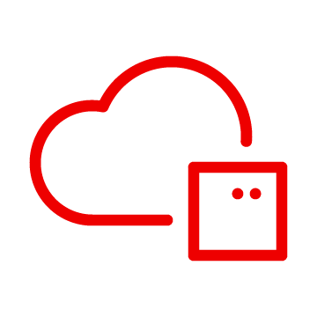





Reality of enterprise IT environments
Diverse app portfolios, mixed infrastructure environments & limited automation
Infrastructure
Applications
Development, IT processes,
and skills
Bare metal
Virtualization
Private cloud
AI/ML
Analytics
Serverless
Developer
tools
Pipeline and
processes
Serverless
Edge
Public cloud
Cloud-native and microservices
People and
policies
The right
skills
Java™
.Net
ISV
Source: Red Hat detail. “The State of Enterprise Open Source,” Feb. 2021.
Notes:
When you look at this all together, it’s a complicated reality. Especially when you factor in the need to do everything with…

Slide 10
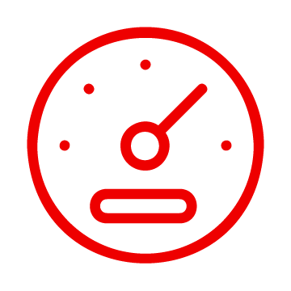


Ingredients for survival
Speed
Stability
Scale
Innovate at
continuous speed.
Operate consistently
and with stability.
Be ready for today, and build for the future with scalability.
Notes:
Speed, stability and scale, in order to not only win markets, but survive.
Let’s face it - when you sacrifice speed, you lose time in the market.
Plus, you need stability. An unstable environment is an unprofitable environment. You need stability and consistency to maintain customer trust and operate to your potential.
And, you need to be agile enough to grow or contract with urgency and immediacy. You need to be able to scale on demand without disrupting your operations, and know that you’re going to be able to scale no matter what next quarter or next year looks like.

Slide 11

Ingredients for survival
Notes:
Speed, stability and scale, in order to not only win markets, but survive.
Let’s face it - when you sacrifice speed, you lose time in the market.
Plus, you need stability. An unstable environment is an unprofitable environment. You need stability and consistency to maintain customer trust and operate to your potential.
And, you need to be agile enough to grow or contract with urgency and immediacy. You need to be able to scale on demand without disrupting your operations, and know that you’re going to be able to scale no matter what next quarter or next year looks like.

Slide 12
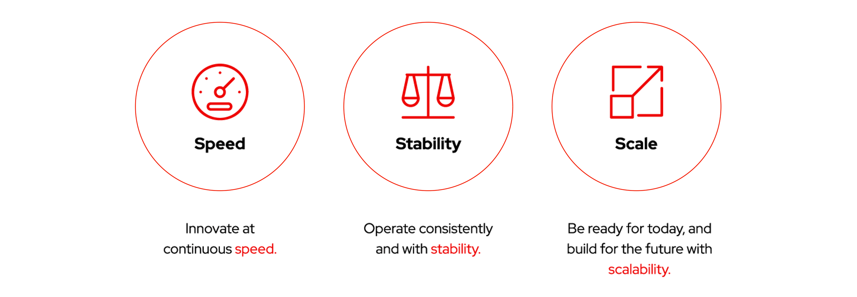
The new world demands all three
Notes:
There was a time when you could have any two of these, but, today, in order to survive, you need all three, plus…

Slide 13
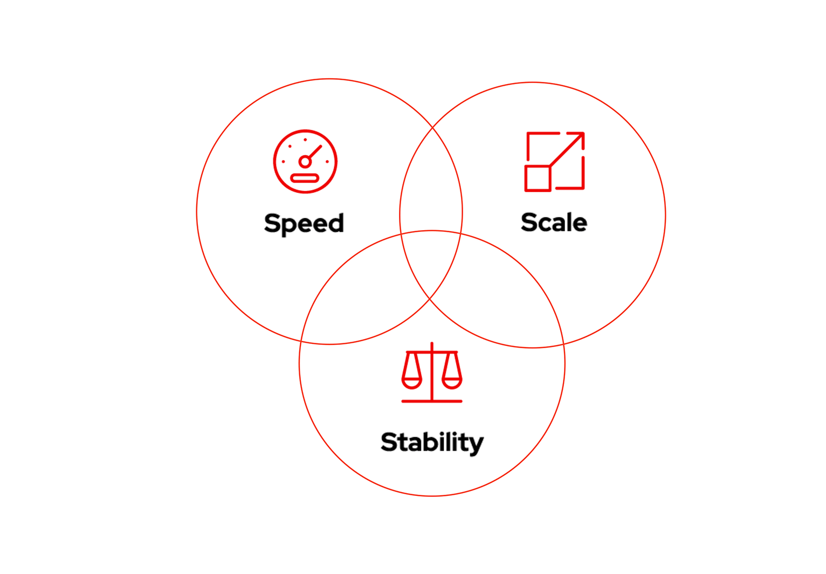
The new world demands all three, plus
Notes:
…And perhaps most importantly, you need to add security and compliance into the mix. If your security isn’t hardened, and you’re not meeting your compliance requirements, everything else that you’ve built can be hobbled instantaneously.
Security keeps your systems running the way they should, and protected from adversity, both internal and external.

Slide 14
[[Note for users: Choose the 3 industries that are most relevant on the next collection of slides to present the most useful scenarios to your audience.]]
Notes:
Choose between:
Telecommunications and banking for speed
Logistics and public sector for stability
Healthcare and automotive for scale

Slide 15
Security concerns can hinder innovation
57%
55%
32%
worry the most about security workloads at runtime¹
have delayed or slowed down application deployment into production due to container or Kuberentes security concerns¹
have concerns about the inherent security of enterprise code²
¹ State of Kuberentes security report 2022
² Source: The State of Enterprise Open Source: A Red Hat Report, 2022. Full report: red.ht/enterprise
Notes:
And when you’re not sure about your security, it can hold your organization back

Slide 16


In the telecommunications industry, there is intense pressure to deliver high-quality, highly available services at the speed of customer demand.
Global mobile data use is expected to increase by 3.6x over the next six years.¹
In a competitive marketplace, speed is a non-negotiable differentiator.²
¹ GSMA. “The mobile economy 2022,” 2022.
² Deloitte. “Deloitte 2022 telecom industry outlook,” May 2022.
Notes:
Let’s start with telecommunications.
In the telecommunications industry, there is intense pressure to deliver high-quality, highlight available services at the speed of customer demand. It is a highly competitive and quickly growing industry, and speed is a non-negotiable differentiator.

Slide 17


In the banking industry, tech is initiating a new wave of disruption, forcing banks to operate with speed
Open banking transforms how institutions need to think about tech and security.¹
Everything is mobile: 89% of customers use mobile banking regularly.²
¹ Srinivas, Val, Jan-Thomas Schoeps, Tiffany Ramsay, Richa Wadhwani, Samia Hazuria, and Aarushi Jain. “2020 banking and capital markets outlook: Fortifying the core for the next wave of disruption.” Deloitte Insights, Dec. 2019.
² Meola, Andrew. “Digital trends disrupting the banking industry in 2020.” Business Insider, Aug. 2019.
Notes:
Let’s start with financial services.
In the banking industry, technology is driving a new wave of disruption. Everything from Open Banking to ubiquitous mobile technology is changing the way banks think about their interactions with customers and many are making changes to adapt.
To keep up with the industry, banks need to deliver new IT systems and services fast.

Slide 18
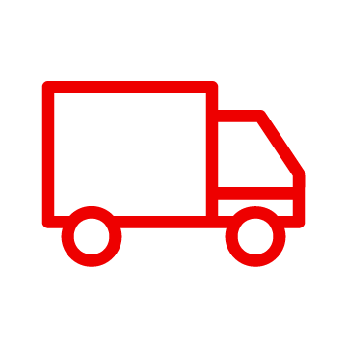

In the shipping industry, digital system stability has become mandatory as demand explodes
“ eCommerce, cloud infrastructure, digital media,
pharmaceuticals, and some transportation and
telecom services will see increased demand.” ¹
Andrew Bartels
Forrester
¹ Bartels, Andrew. “The 2020 To 2021 Tech Market Outlook At A Time Of Global Pandemic And Economic Recession.” Forrester Webinar, April 2020.
Notes:
And in the logistics and shipping industry, digital system STABILITY has become mandatory as demand has exploded in our current pandemic environment.

Slide 19

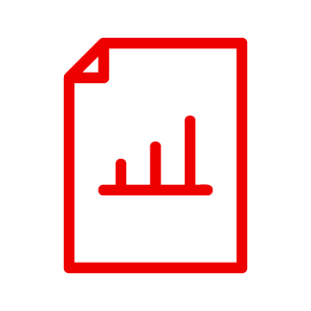
The public sector faces shifting legislative priorities, budget constraints, and legacy infrastructure, but stability is non-negotiable.
“Governments should evaluate legacy applications and
portfolios against modern capabilities to identify
potential areas to use new APIs and capabilities to
replace legacy features and functions.”¹
A UK government report found the country was likely to spend up to £22 billion maintaining support for obsolete systems.²
¹ Deloitte. “Tech Trends 2022: Peering through the lens of government,” 2021.
² Independent report. “Organising for digital delivery,” 22 July 2021.
Notes:
The public sector is under constant pressure - from changing politics and shifting legislative priorities, to budget constraints, and decades of legacy infrastructure - yet must remain stable, secure, and always available to constituents. Around the world public sector organizations are struggling to to remain stable, while people expect from them the same response and reliability as commercial organizations.

Slide 20

The increased pressure on the healthcare industry, is forcing massive scale of digital systems.
“Patients are moving across the care continuum faster, and providers have a shorter window of time to deliver care right.”¹
“The pandemic was an accelerator of several trends, including shifting consumer preferences, rapidly evolving technologies…and clinical innovation.”²
¹ Wessinger, Dave, “The year of large-scale healthcare disruption: 2022 predictions,” Forbes. 23 Feb 2022.
² Deloitte Insights. “Digital transformation: From a buzzword to an imperative for health systems,” 26 Oct 2021.
Notes:
For the healthcare industry, scale is more important than ever. The pandemic showed how many healthcare organizations didn’t have what it takes to scale up rapidly in a crisis, and many within the industry are looking at ways to accommodate scalability.

Slide 21



Data, the new fuel of the automotive industry, is forcing massive scale of digital systems ¹
Auto manufacturers are becoming IoT platform and device companies
Real-time data analysis through AI/ML is key to successful autonomous driving systems
¹ Meola, Andrew. “How 5G and IoT are driving the connected smart vehicle industry.” Business Insider, March 2020.
Notes:
For Auto companies, data has become the new “fuel” and this is forcing massive scale of digital systems.
Auto manufacturers are essentially IoT and device companies now.
And they are using AI/ML for real time analysis of data to support autonomous driving platforms.

Slide 22
[[Note for users: Choose between these questions to spark conversation]]
Notes:
Choose between these questions to spark conversation

Slide 23

What is happening
in your world?
Notes:
So, let’s pause for a moment, and let me ask you: what is happening in your world today? What are the forcing functions that are driving your strategies and tactics?
What are two things that are top of mind when you think about meeting your goals?
What do your next 12 to 18 months look like?
<Give customer a chance to talk>
Well, every industry, including yours, is experiencing strong forcing functions that are impacting both the goals and execution of IT organizations.
Let’s look at a few.

Slide 24

Which of those industry issues resonates most with you?
Notes:
So, let’s pause for a moment, and let me ask you: what is happening in your world today? What are the forcing functions that are driving your strategies and tactics?
What are two things that are top of mind when you think about meeting your goals?
What do your next 12 to 18 months look like?
<Give customer a chance to talk>
Well, every industry, including yours, is experiencing strong forcing functions that are impacting both the goals and execution of IT organizations.
Let’s look at a few.

Slide 25
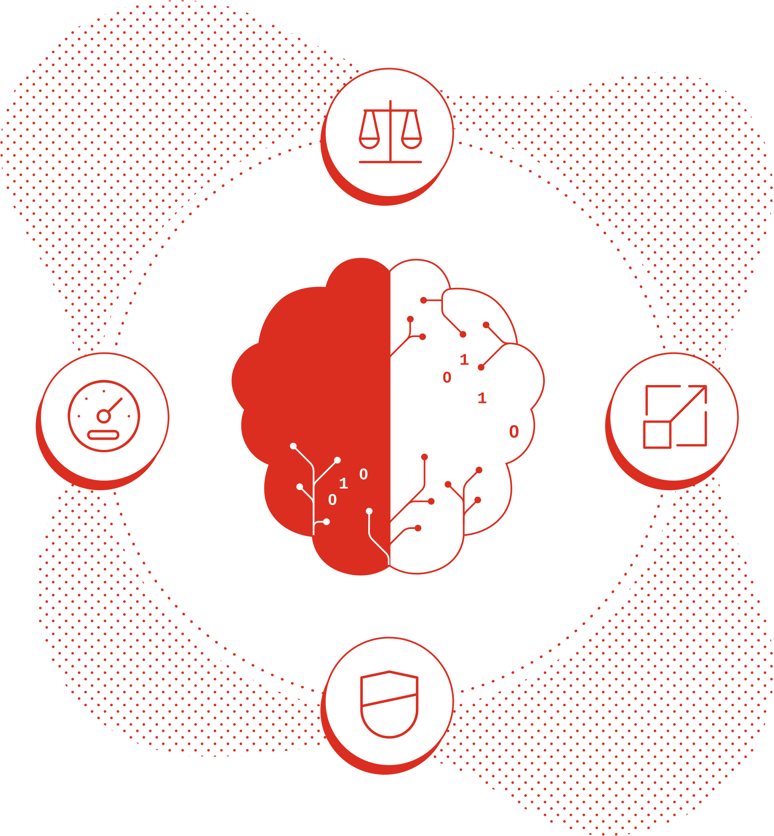
Which of these elements is most on your mind? Speed, stability, scalability, or security?
Notes:
So, let’s pause for a moment, and let me ask you: what is happening in your world today? What are the forcing functions that are driving your strategies and tactics?
What are two things that are top of mind when you think about meeting your goals?
What do your next 12 to 18 months look like?
<Give customer a chance to talk>
Well, every industry, including yours, is experiencing strong forcing functions that are impacting both the goals and execution of IT organizations.
Let’s look at a few.

Slide 26

How have you seen your priorities shift over the past few years?
Notes:
So, let’s pause for a moment, and let me ask you: what is happening in your world today? What are the forcing functions that are driving your strategies and tactics?
What are two things that are top of mind when you think about meeting your goals?
What do your next 12 to 18 months look like?
<Give customer a chance to talk>
Well, every industry, including yours, is experiencing strong forcing functions that are impacting both the goals and execution of IT organizations.
Let’s look at a few.

Slide 27




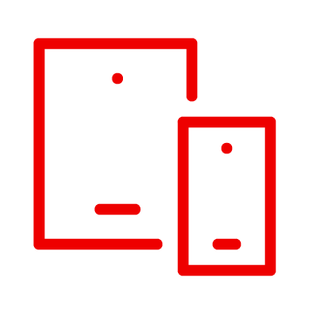






How do you deliver business innovation faster in a complex world?
Development Speed
Operations Scale
Architecture Stability
Cam - can you find a way to incorporate security surrounding speed, scale, stability as we do earlier in the deck?
Flexibility Consistency Efficiency
Bare metal
Virtual
Private cloud
Public cloud
Edge
Notes:
How do you move faster with the stability and scale that you need in this wild hybrid mix of applications, processes and infrastructure?
How can you help your Development, Architecture and Operations teams work together to efficiently deliver software with speed, stability and scale with consistency across hybrid environments from bare metal servers to public cloud to edge cloud or even multiple clouds?
How can you provide flexibility and consistency to allow teams to efficiently build and run their software where best suited?

Slide 28

V1
How do you deliver business innovation faster in a complex world?
Security
Development Speed
Operations Scale
Architecture Stability
Cam - can you find a way to incorporate security surrounding speed, scale, stability as we do earlier in the deck?
Flexibility Consistency Efficiency
Bare metal
Virtual
Private cloud
Public cloud
Edge
Notes:
How do you move faster with the stability and scale that you need in this wild hybrid mix of applications, processes and infrastructure?
How can you help your Development, Architecture and Operations teams work together to efficiently deliver software with speed, stability and scale with consistency across hybrid environments from bare metal servers to public cloud to edge cloud or even multiple clouds?
How can you provide flexibility and consistency to allow teams to efficiently build and run their software where best suited?

Slide 29
V2
How do you deliver business innovation faster in a complex world?
Development Speed
Operations Scale
Security
Architecture Stability
Cam - can you find a way to incorporate security surrounding speed, scale, stability as we do earlier in the deck?
Flexibility Consistency Efficiency
Bare metal
Virtual
Private cloud
Public cloud
Edge
Notes:
How do you move faster with the stability and scale that you need in this wild hybrid mix of applications, processes and infrastructure?
How can you help your Development, Architecture and Operations teams work together to efficiently deliver software with speed, stability and scale with consistency across hybrid environments from bare metal servers to public cloud to edge cloud or even multiple clouds?
How can you provide flexibility and consistency to allow teams to efficiently build and run their software where best suited?

Slide 30

V3
How do you deliver business innovation faster in a complex world?
Development Speed
Operations Scale
Security
Architecture Stability
Flexibility Consistency Efficiency
Bare metal
Virtual
Private cloud
Public cloud
Edge
Notes:
How do you move faster with the stability and scale that you need in this wild hybrid mix of applications, processes and infrastructure?
How can you help your Development, Architecture and Operations teams work together to efficiently deliver software with speed, stability and scale with consistency across hybrid environments from bare metal servers to public cloud to edge cloud or even multiple clouds?
How can you provide flexibility and consistency to allow teams to efficiently build and run their software where best suited?

Slide 31
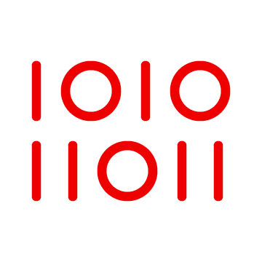

Cam: refer to labels in this deck https://docs.google.com/presentation/d/1nDnPs-ZUWB_Tp8dH5M-ft-tgOU_NmjW8SmTH5N66iG8/edit#slide=id.gf23eaffd2b_0_1
By taking a hybrid cloud approach
Development tools
Management and automation systems
Applications, data platforms, and operating system
Bare metal
Virtual
Private cloud
Public cloud
Edge
Notes:
By taking a hybrid cloud approach.
It’s our recommended strategy for architecting, developing, and operating a hybrid mix of applications, delivering a truly flexible cloud experience with the speed, stability and scale required for digital business transformation.
The specific products and consulting services of open hybrid cloud are not one-size-fits-all, but they do share a common technological foundation: Red Hat® Enterprise Linux® and our Kubernetes platform Red Hat OpenShift®. Additionally, Open Hybrid Cloud involves using:
Platforms - to run both traditional and new, cloud-native workloads anywhere—from the data center to the edge
Development tools - to rapidly build innovative applications that can be highly integrated and continuously deployed
Management technologies and systems - to enable automation across applications, teams and processes
Managed Services - so customers can consume these technologies as services and leave the operations to us
Training and services - to help teams improve their processes in order get the most out of an open hybrid cloud approach
Partner ecosystem - to give customers technologies that tested, supported and certified to with most major cloud, hardware, and software providers.
It is open because it is based on
enterprise open source software for access to stable community innovation
open standards for broad compatibility
and open APIs for flexible integrations
All of this sits on one common technological foundation: Red Hat Enterprise Linux and our Kubernetes platform Red Hat OpenShift.

Slide 32
Cam: refer to labels in this deck https://docs.google.com/presentation/d/1nDnPs-ZUWB_Tp8dH5M-ft-tgOU_NmjW8SmTH5N66iG8/edit#slide=id.gf23eaffd2b_0_1
By taking a hybrid cloud approach
Traditional
N-tier apps
Cloud-native
microservices
Data, analytics, and AI/ML
ISV packaged apps
Development tools
Management and automation systems
Applications, data platforms, and operating system
Bare metal
Virtual
Private cloud
Public cloud
Edge
Notes:
By taking a hybrid cloud approach.
It’s our recommended strategy for architecting, developing, and operating a hybrid mix of applications, delivering a truly flexible cloud experience with the speed, stability and scale required for digital business transformation.
The specific products and consulting services of open hybrid cloud are not one-size-fits-all, but they do share a common technological foundation: Red Hat® Enterprise Linux® and our Kubernetes platform Red Hat OpenShift®. Additionally, Open Hybrid Cloud involves using:
Platforms - to run both traditional and new, cloud-native workloads anywhere—from the data center to the edge
Development tools - to rapidly build innovative applications that can be highly integrated and continuously deployed
Management technologies and systems - to enable automation across applications, teams and processes
Managed Services - so customers can consume these technologies as services and leave the operations to us
Training and services - to help teams improve their processes in order get the most out of an open hybrid cloud approach
Partner ecosystem - to give customers technologies that tested, supported and certified to with most major cloud, hardware, and software providers.
It is open because it is based on
enterprise open source software for access to stable community innovation
open standards for broad compatibility
and open APIs for flexible integrations
All of this sits on one common technological foundation: Red Hat Enterprise Linux and our Kubernetes platform Red Hat OpenShift.

Slide 33
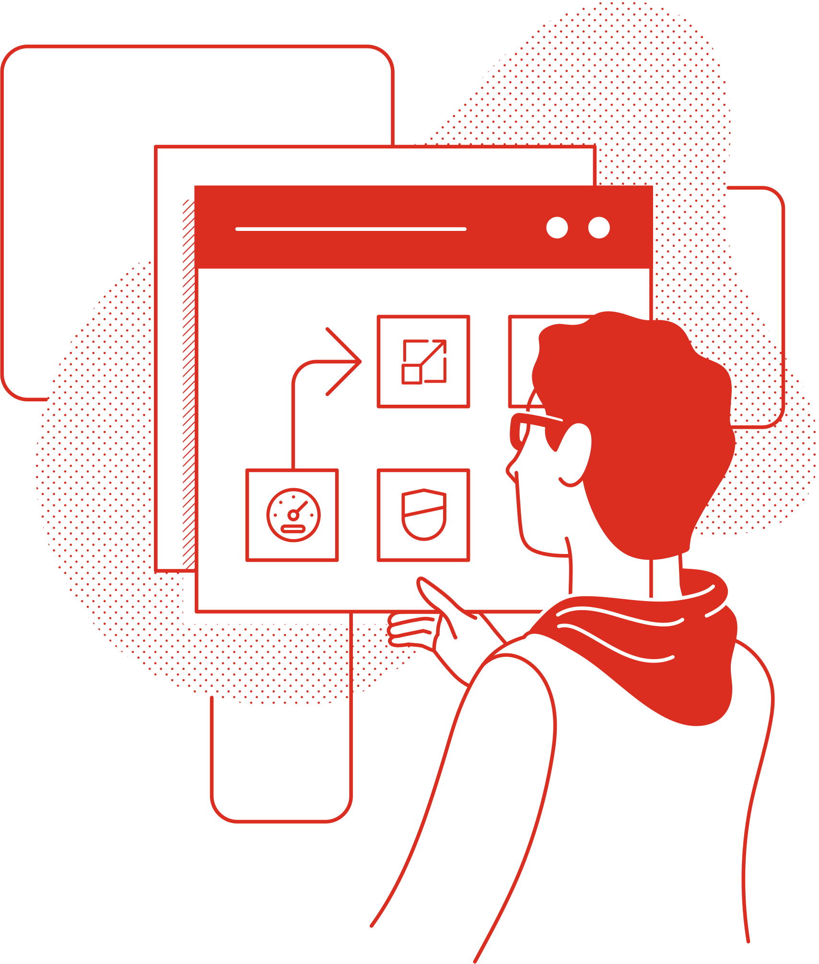
Support every app. Span every cloud. Modernize your environment.
Build modern applications to meet any need, and run them anywhere without limits.
Notes:
A hybrid cloud approach allows you to:
Support every app. Span every cloud. Modernize your environment.
Build modern applications to meet any need, and run them anywhere without limits.

Slide 34

Hybrid cloud can help your organization achieve:
Speed
Scalability
Stability
Security
Notes:
An open hybrid cloud strategy ultimately enables some key capabilities required for IT to be successful:
Speed to develop and deliver application services faster for the business
Flexibility to allow applications to run wherever is most appropriate
Agility to adapt to changing requirements, environments, and technologies over time
A focus on security to facilitate the delivery of innovation without risk
Portability to allow workloads and applications to be moved to the most suitable environments
Openness to empower choice and use of the best technologies and platforms from an extensive ecosystem

Slide 35


Hybrid cloud helps your organization achieve
Speed
Scalability
Stability
Security
Flexibility
Agility
Portability
Openness
Notes:
An open hybrid cloud strategy ultimately enables some key capabilities required for IT to be successful:
Speed to develop and deliver application services faster for the business
Flexibility to allow applications to run wherever is most appropriate
Agility to adapt to changing requirements, environments, and technologies over time
A focus on security to facilitate the delivery of innovation without risk
Portability to allow workloads and applications to be moved to the most suitable environments
Openness to empower choice and use of the best technologies and platforms from an extensive ecosystem

Slide 36

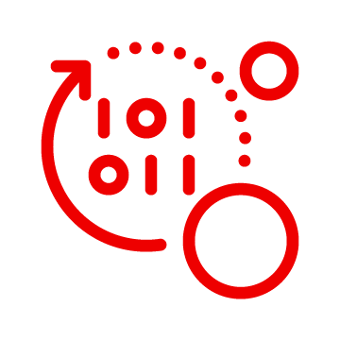

Which hybrid cloud outcome would
help you deliver digital differentiation?
Deliver innovative applications faster
Architect a stable and security-focused hybrid cloud foundation
Manage and automate across hybrid cloud
Put digital transformation into practice
Adopt new global delivery models
Notes:
So, given your goals, and your current state, which of these outcomes of a hybrid cloud strategy do you think would help your organization most?
[[Discussion]]
Do you have an Architecture that is flexible enough to support this hybrid world? If your direction changes, are you ready to make adjustments quickly?
We’ve solved for these issues with Red Hat OpenShift.

Slide 37

We built Red Hat OpenShift so any organization could thrive in a world of hybrid possibility
Notes:
We built Red Hat OpenShift so any organization could thrive in a world of hybrid possibility. How?

Slide 38
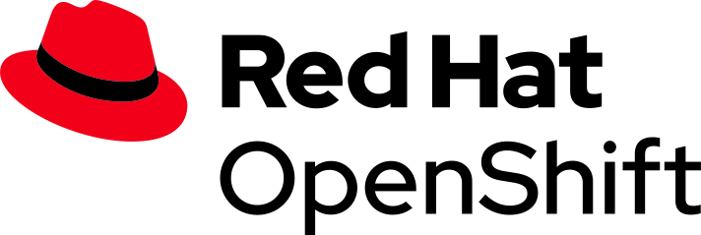
A single platform for application innovation
Empowering developers to innovate Get applications to production sooner with a wide range of technologies and streamlined workflows
A cloud-like experience, everywhere Full-stack and automated operations on a consistent foundation for on-premises or hybrid cloud infrastructures
Trusted enterprise Kubernetes Continuous security, world-class support and services, and deep expertise to confidently run any application
Notes:
In delivering an Open Hybrid Cloud, Red Hat OpenShift plays a key part in providing a trusted, enterprise Kubernetes platform. We add productive features such as IDE, runtimes, build pipelines, monitoring, security, and service mesh and more to deliver an application platform with all the components you need that are fully integrated to build, deploy, and manage containerized applications.
We take container security very seriously and take a holistic approach to deliver a trusted enterprise Kubernetes platform. As you know, containers are Linux, and so is Kubernetes. And because we also provide Red Hat Enterprise Linux, which is trusted by 1,000s of enterprises worldwide, we can deliver a secure platform across the stack and stand behind it with long-term support.
We recognize that keeping up with the frequent upstream releases can be challenging. We’re investing in automated capabilities like the operator framework and over-the-air updates to make it easier to keep up to date with the latest innovations coming out of the communities and deploy containers at scale.
It’s all about the developers, and we’re investing in:
Automation capabilities in OpenShift, continuous integration/continuous deployment pipelines, AB testing, and more.
Developer tools like CodeReady Workspaces
Cloud-native frameworks including Spring, serverless, and Windows containers to inspire developers to create the best code.
No matter what applications you’re building, chances are you can improve developer productivity with OpenShift.

Slide 39
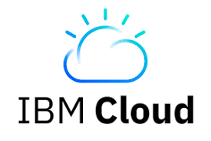
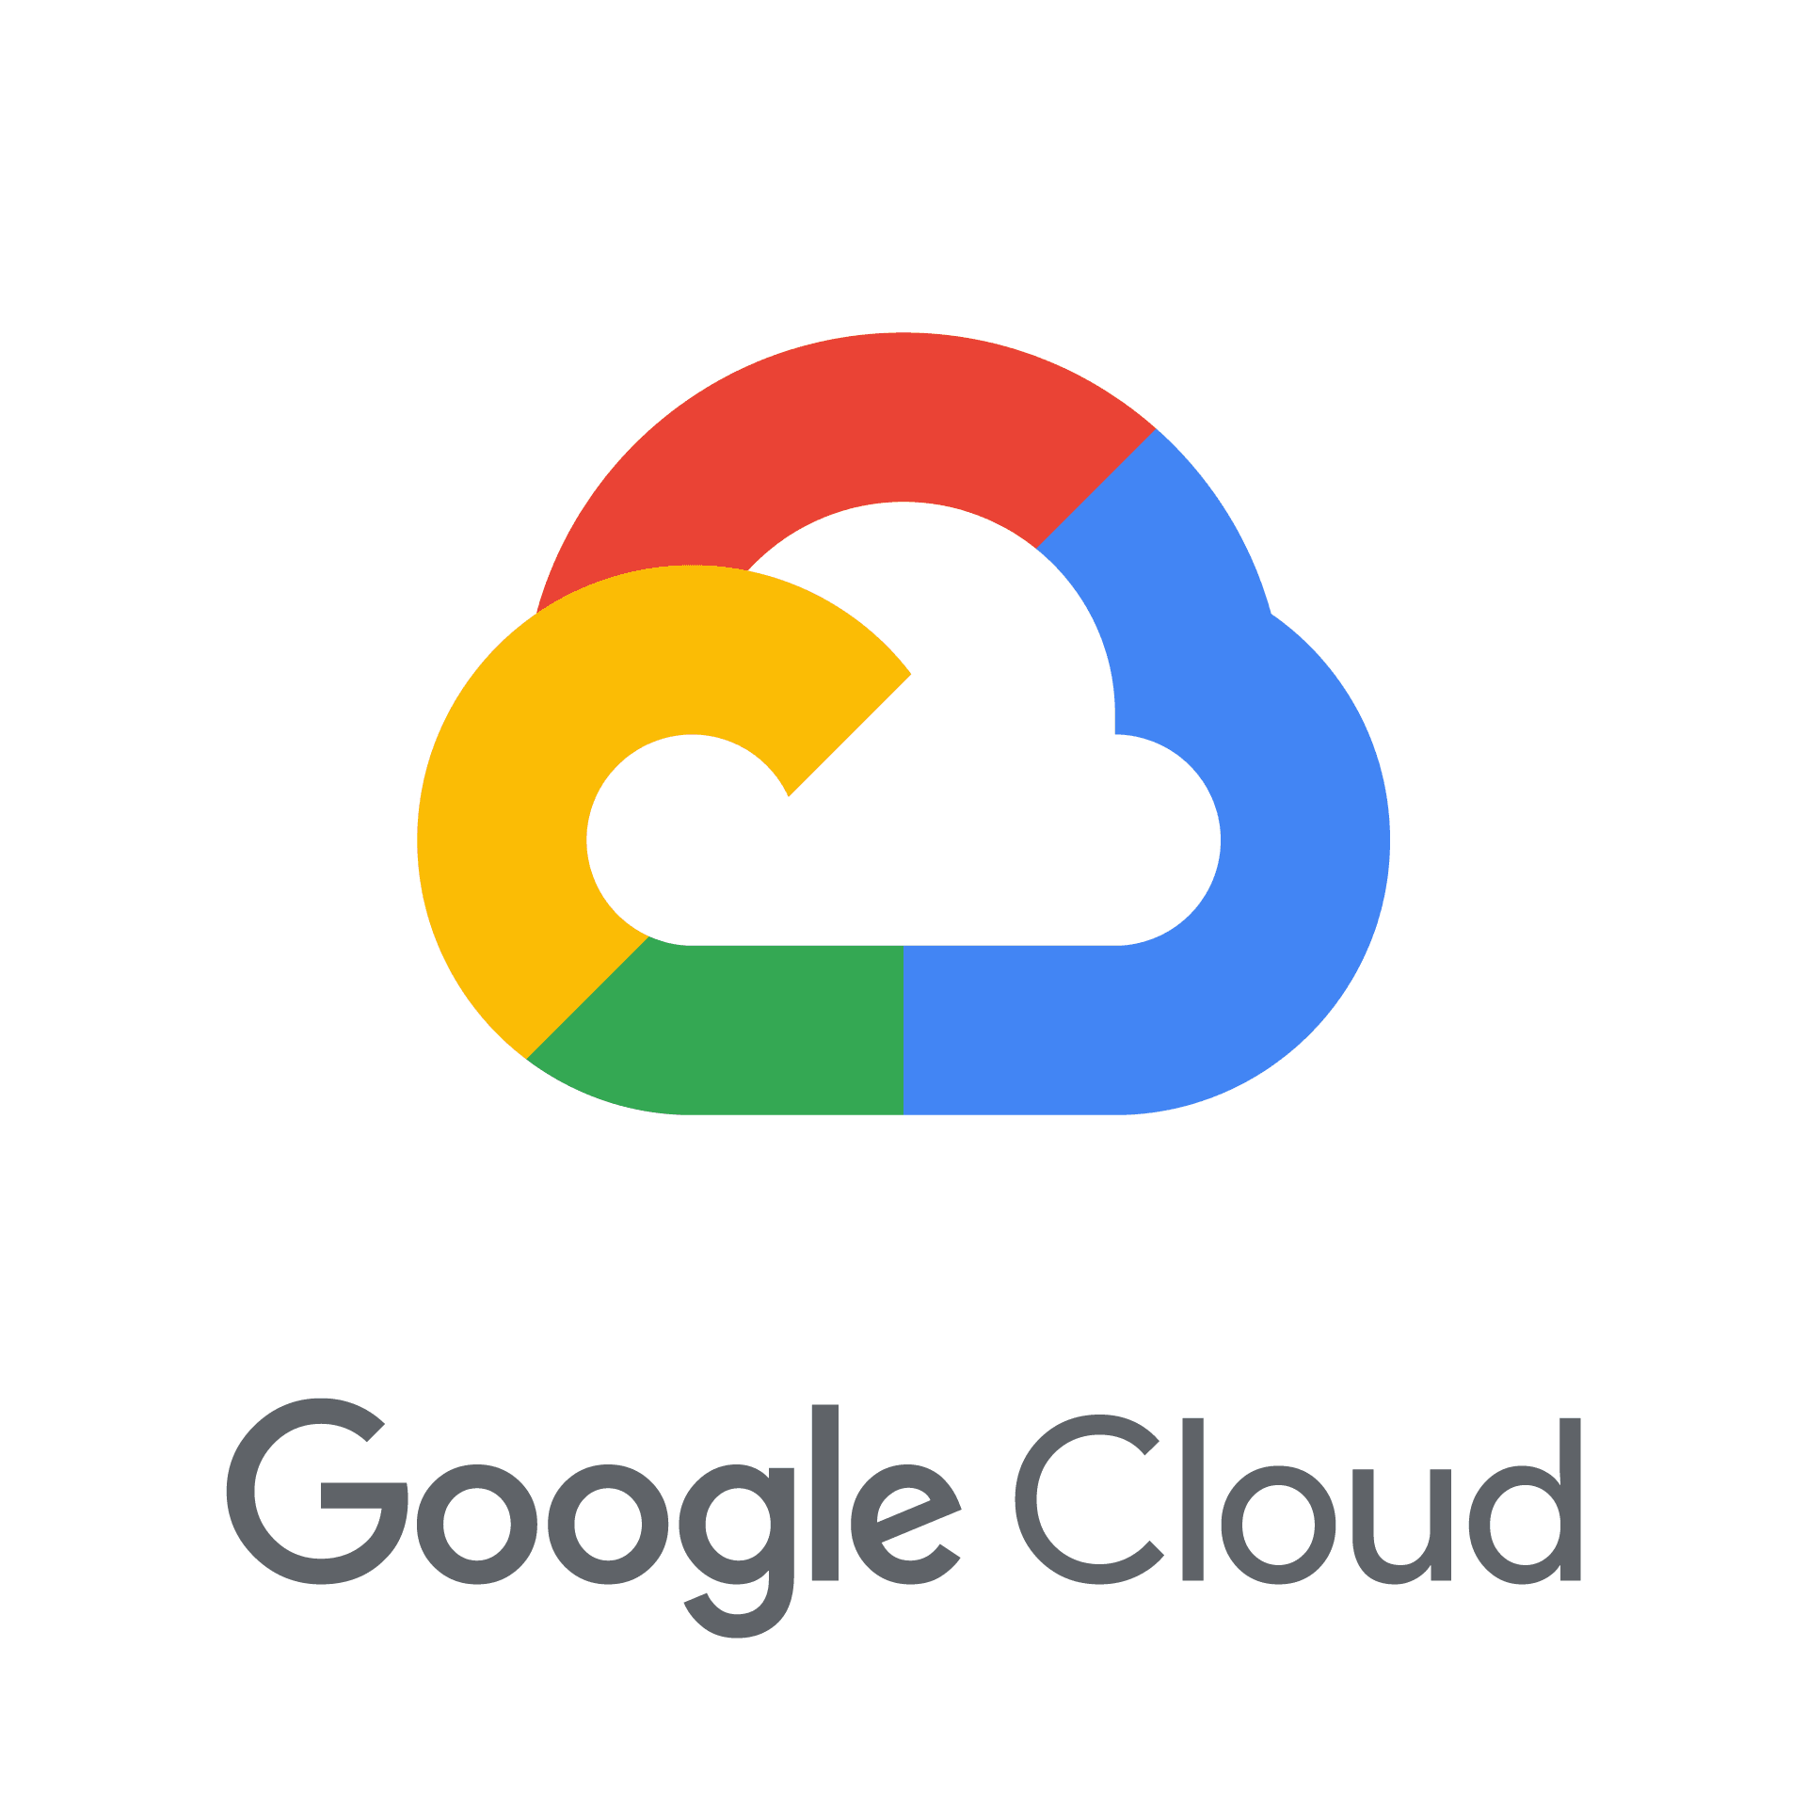

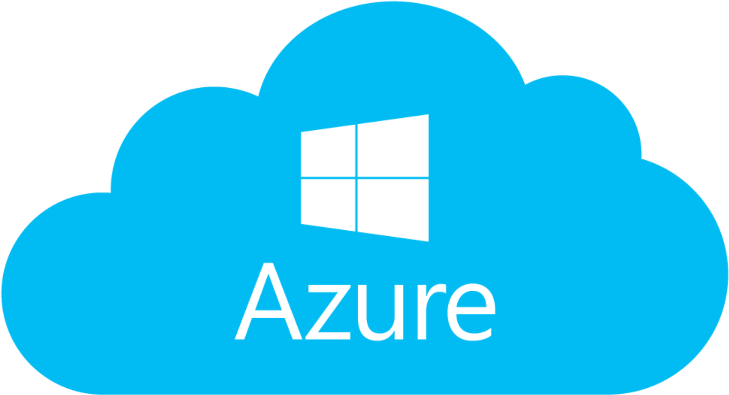
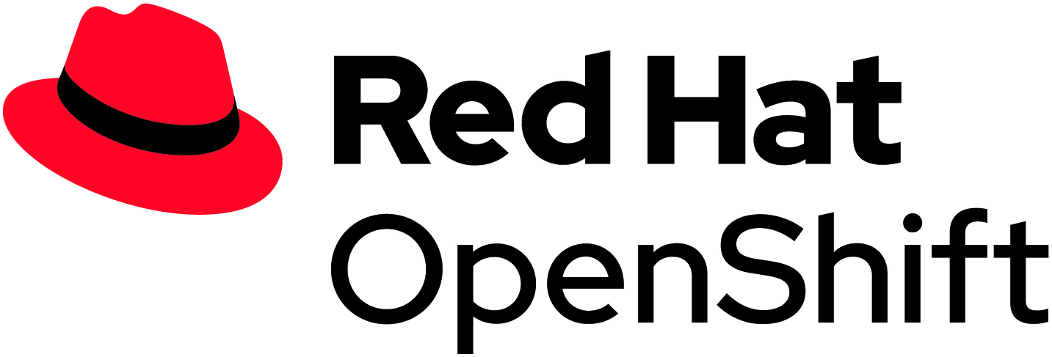
OpenShift is available as self-managed platform or fully managed cloud service
Managed Red Hat OpenShift Services - Cloud managed, start quickly
Red Hat OpenShift Service on AWS
Azure Red Hat OpenShift
Red Hat OpenShift on IBM Cloud
Red Hat OpenShift Dedicated
Self-Managed Red Hat OpenShift - Customer managed, for control and flexibility
On public cloud, or on-premises on physical or virtual infrastructure
Notes:
OpenShift is available as a self-managed platform or as a fully managed cloud service
OpenShift Platform Plus is a self-managed software solution that you can deploy in your datacenter, public cloud(s) or edge locations
OpenShift Managed Services include OpenShift Dedicated, Azure Red Hat OpenShift, OpenShift Service on AWS and OpenShift on IBM Cloud are fully managed for you by Red Hat and our service provider partners
You can choose the model that best suits your needs or a combination of both

Slide 40





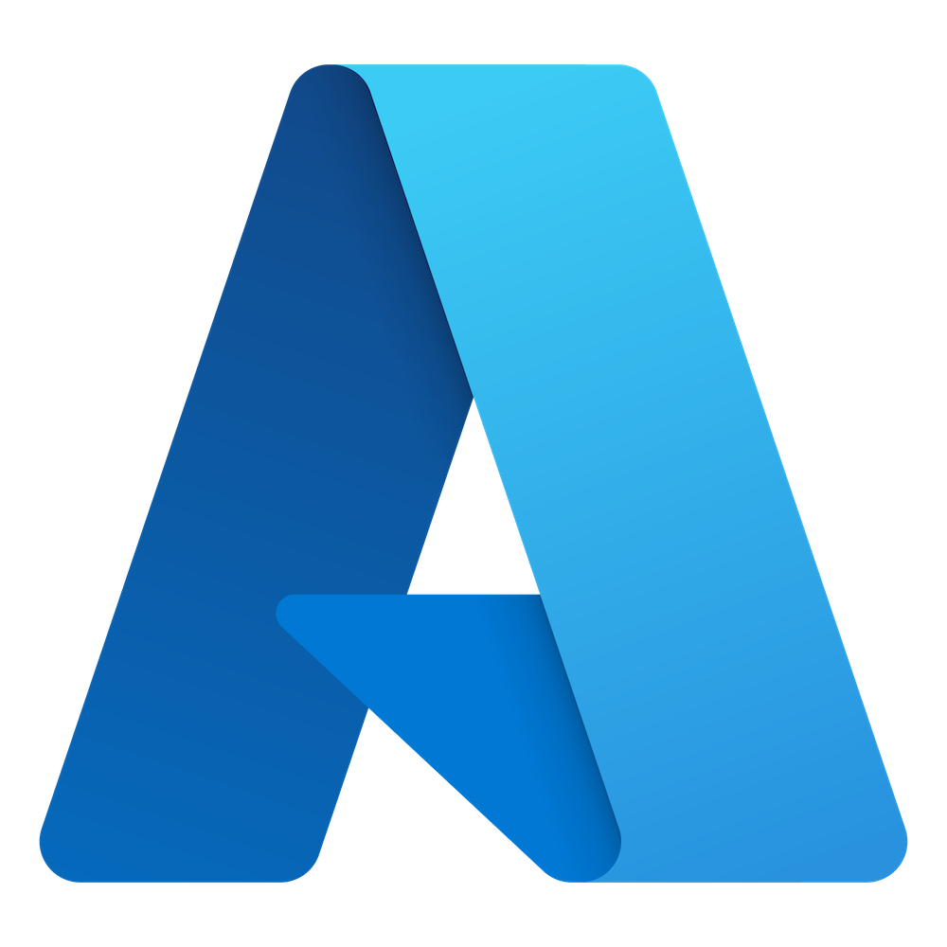



Build and run a platform versus a cloud service
The Engine
The Parts
The Assembled Car
The Full Service
Support and Operations
Monitoring
Service Mesh
Dev Tools
Monitoring
Service Mesh
Dev Tools
Monitoring
Service Mesh
Dev Tools
Registry
Metrics
Logging
CI/CD
Registry
Metrics
Logging
CI/CD
Registry
Metrics
Logging
CI/CD
Kubernetes Cluster Services
Basic Networking :: Ingress
Kubernetes Cluster Services
Basic Networking :: Ingress
OpenShift Cluster Services
Networking :: Router :: OLM
OpenShift Cluster Services
Networking :: Router :: OLM
Kubernetes
Kubernetes
Kubernetes
Kubernetes
Custom OS
Custom OS
Red Hat Core OS
Red Hat Core OS
xKS
xKS plus ‘native’ services
Self-managed
Red Hat OpenShift
Red Hat OpenShift Service on AWS

Slide 41


Build and run a platform versus a cloud service
The Engine
The Parts
The Assembled Car
The Full Service
Support and Operations
Monitoring
Service Mesh
Dev Tools
Monitoring
Service Mesh
Dev Tools
Monitoring
Service Mesh
Dev Tools
Registry
Metrics
Logging
CI/CD
Registry
Metrics
Logging
CI/CD
Registry
Metrics
Logging
CI/CD
Kubernetes Cluster Services
Basic Networking :: Ingress
Kubernetes Cluster Services
Basic Networking :: Ingress
OpenShift Cluster Services
Networking :: Router :: OLM
OpenShift Cluster Services
Networking :: Router :: OLM
Kubernetes
Kubernetes
Kubernetes
Kubernetes
Custom OS
Custom OS
Red Hat Core OS
Red Hat Core OS
xKS
xKS
plus ‘native’ services
Self-managed
Red Hat OpenShift
Red Hat OpenShift Service on AWS

Slide 42




A seamless experience across public and private cloud
Automated operations
Multi-
tenant
Secure by default
Network
traffic control
Over-the-air updates
Monitoring & chargeback
Pluggable architecture
Bare metal, AWS, Microsoft Azure, Google Cloud, IBM Cloud, VMware vSphere, OpenStack, Nutanix, HPE, Dell, Lenovo, Cisco
Notes:
By creating a seamless experience for developers and operators across public and private cloud.
Red Hat OpenShift lets you deploy what you have and what you build anywhere, offering you one uniform environment across public and private cloud environments.

Slide 43

A seamless experience across public and private cloud
Automated operations
Multi-
tenant
Secure by default
Network
traffic control
Over-the-air updates
Monitoring & chargeback
Pluggable architecture
Bare metal, AWS, Microsoft Azure, Google Cloud, IBM Cloud, VMware vSphere, OpenStack, Nutanix, HPE, Dell, Lenovo, Cisco
Notes:
By creating a seamless experience for developers and operators across public and private cloud.
Red Hat OpenShift lets you deploy what you have and what you build anywhere, offering you one uniform environment across public and private cloud environments.

Slide 44
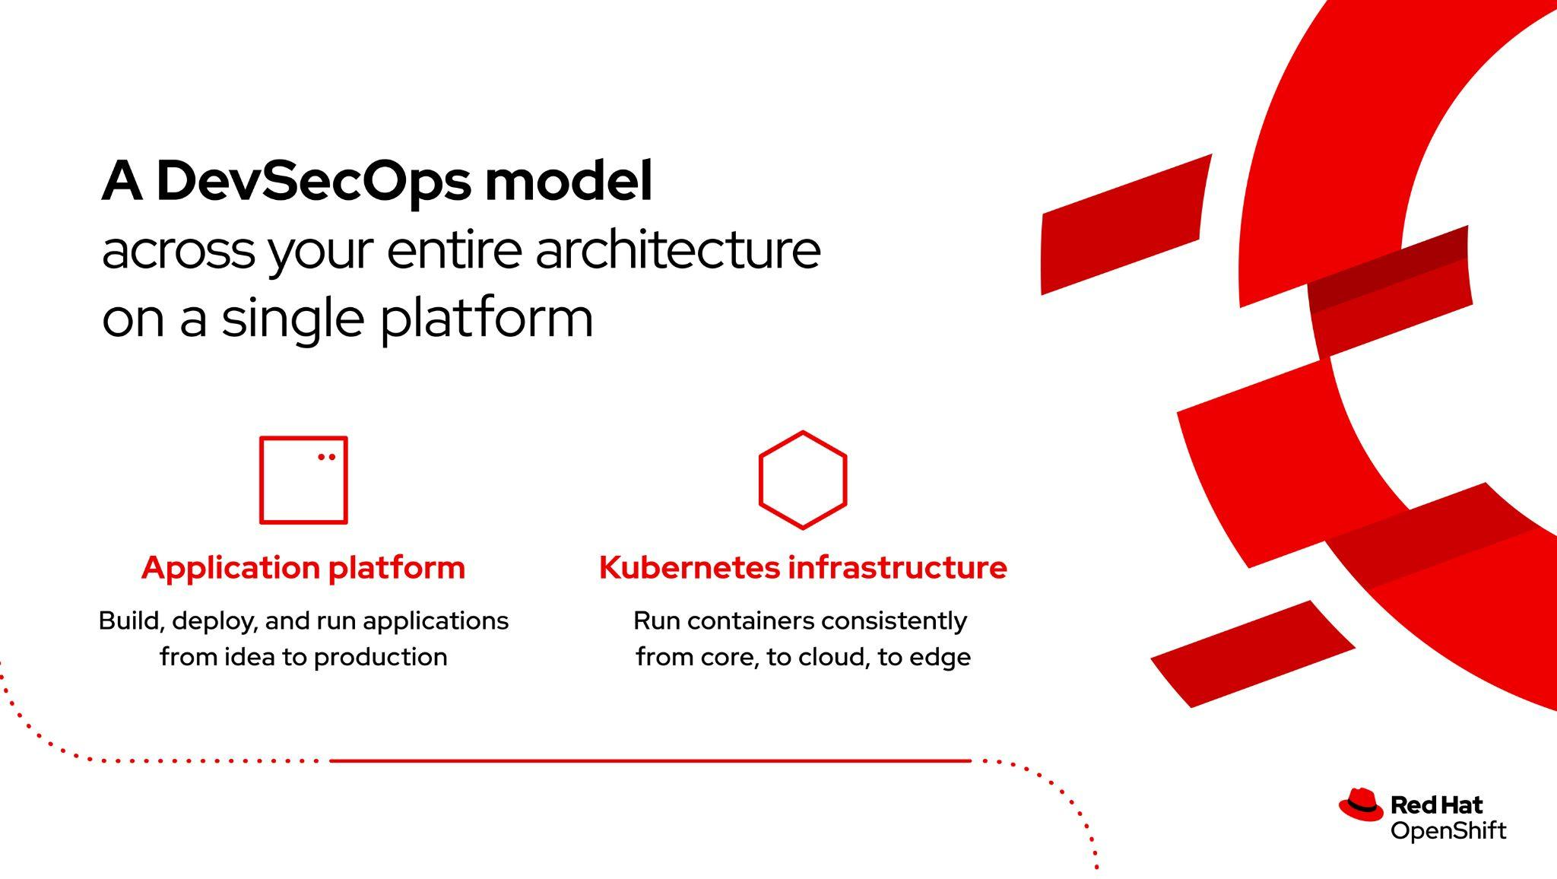
Notes:
Red Hat OpenShift is at the heart of our hybrid cloud strategy. OpenShift provides:
A single platform that provides Kubernetes infrastructure orchestration capabilities with everything you need to run containers consistently from core to cloud to edge
OpenShift® is enterprise Kubernetes
100% CNCF certified Kubernetes
Built on the more secure foundation of Red Hat® Enterprise Linux®
Leadership in community and with customers

Slide 45
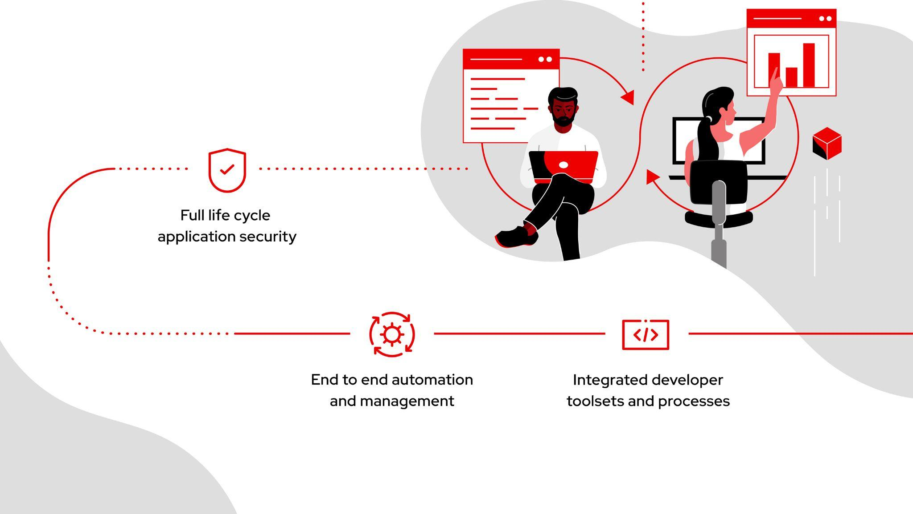
Notes:
It is also a cloud-native application platform that helps accelerate the building, deployment and management of applications at scale
It supports traditional and cloud-native applications, data services, custom built, and third party independent software vendor (ISV) software
It includes runtimes, builds, continuous integration and continuous delivery (CI/CD) pipelines, GitOps, telemetry, service mesh, serverless, and more
Multicluster and multicloud management
Together with full-life cycle application security through Red Hat Advanced Cluster Security, end to end management with Red Hat Advanced Management for Kubernetes, and integrated developer toolsets and processes delivering an integrated DevSecOps experience

Slide 46
The benefits of Red Hat OpenShift
C – level benefits
Faster time to market, innovation, enable Dev/Ops
Business leaders
Product delivery to customers/ revenue / market penetration
Enterprise architecture
Common platform for Dev and Ops, supports legacy and cloud native
Developer benefits
Operators benefits
Infrastructure benefits
Security benefits
Ideas to users
Choice of architectures
Choice of programming languages
Build and deploy workflows
Not having to worry about the Infrastructure
Automated deployments
Automated provisioning
Automated installations
Automated security scanning
Automated upgrades
Automated back ups
Reduction in VM Costs
Higher utilisations
Lower VM costs
Choice of IaaS
Portability
Critical Bug Fix
Minimising the attack potential
Security scanning for Vulnerabilities
Containing the container
66% faster dev lifecycle
34% more apps deployed - hybrid/multicloud
40% infrastructure savings
Security-focused environment

Slide 47






What’s included in Red Hat OpenShift?
Container host and runtime
Enterprise Kubernetes
Validated integrations
Integrated container registry
Developer workflows
Easy access to services

Slide 48

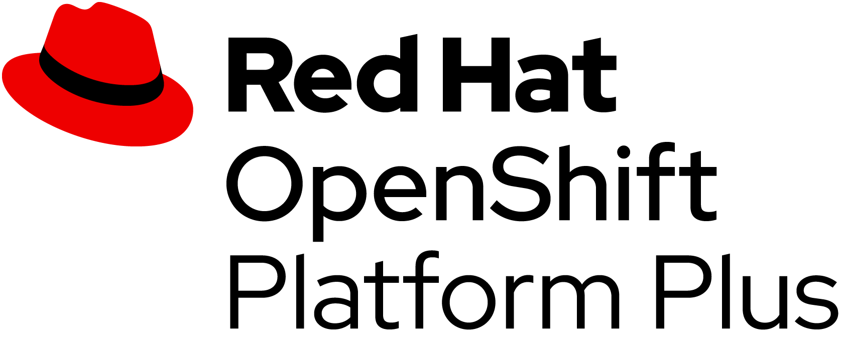
Red Hat OpenShift Platform Plus
Complete platform for deploying, managing and protecting applications across the hybrid cloud
Centralized visibility across the hybrid cloud
Advanced hybrid cloud foundation management tools (ACM)
Elevating multicluster security
Kubernetes-native security with integration across the hybrid cloud (ACS)
Secure the application codebase
Global application and container registry with security scanning services (Quay)
Data services
Consistent cluster data management for container workloads (ODF Essentials)

Slide 49
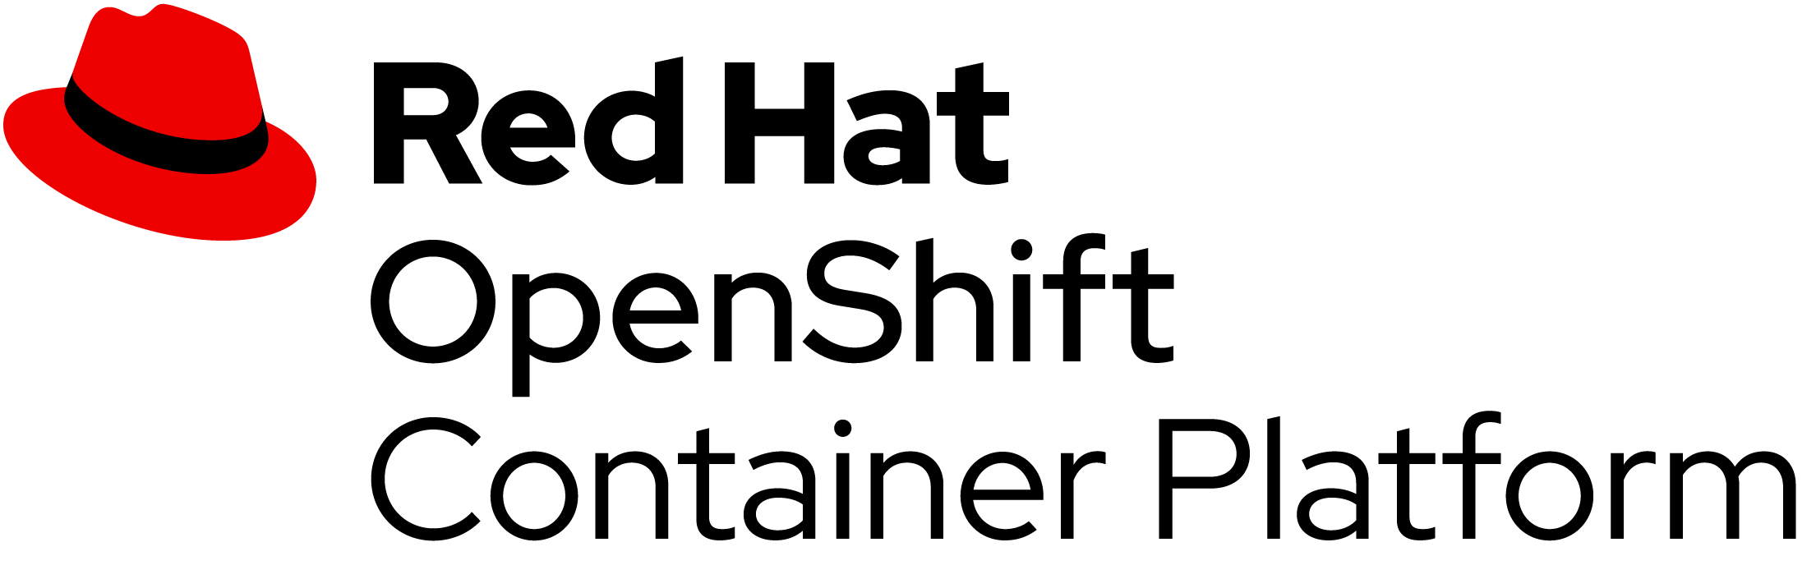

Red Hat OpenShift Container Platform
Complete platform for containerized application deployment
Trusted Enterprise Kubernetes
Immutable infrastructure with RHEL CoreOS and Kubernetes
Cloud-like Experience Everywhere
Complete set of advanced services to enhance controls, monitoring and interfaces
Empowering Developers to Innovate
Integrated with developer workflows to get applications to production sooner
Notes:
Developer focused without all the add ons
OKE is just enough runtime

Slide 50

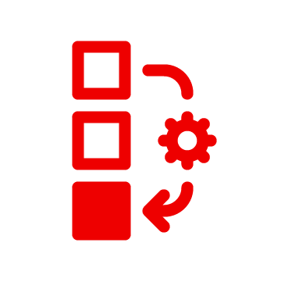

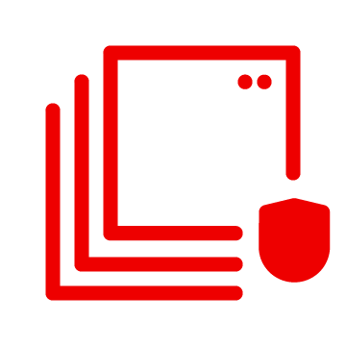
Red Hat OpenShift Container Platform
Complete platform for containerized application deployment
Trusted Enterprise Kubernetes
Immutable infrastructure with RHEL CoreOS and Kubernetes
Cloud-like Experience Everywhere
Complete set of advanced services to enhance controls, monitoring and interfaces
Empowering Developers to Innovate
Integrated with developer workflows to get applications to production sooner
Notes:
Developer focused without all the add ons
OKE is just enough runtime

Slide 51
“Red Hat OpenShift has allowed us to improve our development practices so that it’s more built-for-the-cloud... This results in faster development cycles and makes it cheaper... and faster to build projects.”
“With Red Hat OpenShift, we can try out different things — in the past, if we had an idea or concept, we couldn’t just quickly try it, so the trial and error is good.”
“We’ve been able to shorten our critical applications release cycles, which used to be monthly but can now be done weekly or in some extreme cases daily hot fixes.”
Why Red Hat OpenShift for business applications?
IDC research: The business value of Red Hat OpenShift
Healthcare
Manufacturing
Media
Source:
IDC White Paper, sponsored by Red Hat, "The Business Value of Red Hat OpenShift", doc # US47539121, February 2021.
Notes:
Now, you might ask “If I’m going all in on AWS, why should I deploy OpenShift if AWS already has container and Kubernetes services?”
IDC has published a research paper based on interviews with a dozen customers that all speak to the business value of OpenShift on AWS.
From increased developer productivity, ease of management, the ability to have a consistent multi-cloud platform, there are many reasons why you should deploy OpenShift on AWS.
But the most important reason is when you read the quote from the hospitality customer that says that they were able to increase revenue by 15% with the help of OpenShift on AWS. When you can generate tens of millions dollars more in revenue, the business case is pretty clear.
Now, let’s go back and take a look at those three industries we touched on before, and get a little more specific.

Slide 52
This section includes
Telecommunications
Banking
Shipping
Public sector
Healthcare
Automotive

Slide 53
In the telecommunications industry, there is intense pressure to deliver high-quality, highly available services at the speed of customer demand.
Global mobile data use is expected to increase by 3.6x over the next six years.¹
In a competitive marketplace, speed is a non-negotiable differentiator.²
¹ GSMA. “The mobile economy 2022,” 2022.
² Deloitte. “Deloitte 2022 telecom industry outlook,” May 2022.
Notes:
So, remember this slide where we talked about the pressure that telecommunications industries are facing?

Slide 54


Telecommunications
To speed service delivery to maintain its competitive advantage, Orange Sonatel built a new platform with Red Hat OpenShift and Red Hat Ansible Automation Platform.
Cut application deployment time from days or weeks to minutes.
Improved developer productivity with self-service IT environment with automation
Notes:
Here’s how one of our telecom customers was able to overcome these challenges. With Red Hat OpenShift and Red Hat Ansible Automation Platform Orange Sonatel were able to cut application deployment time from days or weeks down to minutes. ANd they improved developer productivity by creating a self-service IT environment with automation.

Slide 55
Telecommunications
“When we previously used community Docker on virtual machines, we needed to set up and monitor the environment. With Red Hat OpenShift, developers don’t need to know about the Kubernetes stack underneath, because it’s templated.”
James Kokou Gaglo
DevOps Engineer,
Orange Sonatel
Notes:
They have been able to reduce compute resource requirements by two-thirds, and operate with the speed, efficiency and scale that they need to compete.
Challenge
Deliver high-quality, highly available services at the speed of customer demand. However, using the community version of Docker on virtual machines took the service provider’s team days or even weeks to deploy a new application.
Solution
A cloud-native, DevOps-based approach provided the efficiency and scale needed. Using Red Hat® OpenShift® and Red Hat Ansible® Automation Platform, Orange Sonatel built Malaw, a platform allowing the company to quickly migrate and build core applications.
Why Red Hat
“We selected Red Hat OpenShift because of its leading position in the market and because of its competitive pricing and features. We were impressed by the results of an internal proof of concept that showed how its automation capabilities could help us accelerate our delivery process.” - Moussa Wade, Head of Center of Excellence, Orange Sonatel.
Results
Cut application deployment time from days or weeks to minutes
Improved developer productivity with self-service IT environment and automation
Reduced compute resource requirements by 2/3
Products and services
Red Hat OpenShift
Red Hat OpenShift Container Storage
Red Hat Ansible Automation Platform
Source: Red Hat case study. "Orange Sonatel launches new services in weeks with Red Hat OpenShift," Sep. 2020.

Slide 56
In the banking industry, tech is initiating a new wave of disruption, forcing banks to operate with speed
Open banking transforms how institutions need to think about tech and security.¹
Everything is mobile: 89% of customers use mobile banking regularly.²
¹ Srinivas, Val, Jan-Thomas Schoeps, Tiffany Ramsay, Richa Wadhwani, Samia Hazuria, and Aarushi Jain. “2020 banking and capital markets outlook: Fortifying the core for the next wave of disruption.” Deloitte Insights, Dec. 2019.
² Meola, Andrew. “Digital trends disrupting the banking industry in 2020.” Business Insider, Aug. 2019.
Notes:
Remember these banking challenge?

Slide 57

Banking
ANZ Bank deployed a container application platform to speed development to keep pace with business growth.³
Accelerated deployment time by 98%
Improved developer productivity and collaboration
³ Red Hat video. “ANZ Bank reduces deployment time by 98% with container platform.” YouTube, April 2019.
Notes:
HERE’S HOW WE HELPED A-N-Zed BANK IN AUSTRALIA.
To address this need for speed, A-N-Zed has deployed a container application platform to speed up the development of new banking offerings.
With Red Hat Open Shift, they’ve been able to increase their productivity AND drastically reduced their time to market for services or new functionality – sometimes being able to turn around fixes in as little as 35 to 40 hours.

Slide 58
Banking
“We moved from ticket handling to … demonstrating inventive thinking in network automation development and infrastructure. Red Hat Open Innovation Labs gave us the tools to successfully transform with inspiration and confidence.”
Dave Wasley
Technology Area Lead, Infrastructure
ANZ Bank New Zealand
Source: Red Hat ANZ Bank success snapshot, May 2020.
Notes:
The solution that ANZ Bank developed to help keep up with the pace of business growth is based on Red Hat OpenShift Container Platform.
Their results have included
Accelerated deployment time by 98%, with no downtime
Improved productivity and collaboration, saving 6,000 work hours per year
They’ve been able to scale it across multiple departments
Reduced total cost of ownership (TCO)
Challenge
Migrate from legacy IT environment to a more agile, flexible solution to keep pace with business growth.
Solution
Migrate more than 25 customer service platform services to around 300-400 Red Hat® OpenShift® containers.
Why Red Hat
Red Hat OpenShift Container Platform is able to meet ANZ’s business demands and establish an automated continuous delivery (CD) pipeline.
Results
Accelerated deployment time by 98%, with no downtime
Improved productivity and collaboration, saving 6,000 work hours per year
Reduced total cost of ownership (TCO)
Products and services
Red Hat OpenShift Container Platform
Red Hat Consulting
Source: Red Hat video. “ANZ Bank reduces deployment time by 98% with container platform.” YouTube, April 2019.

Slide 59
Digital system stability has become mandatory for the shipping industry as demand explodes
“ eCommerce, cloud infrastructure, digital media,
pharmaceuticals, and some transportation and
telecom services will see increased demand.” ¹
Andrew Bartels
Forrester
¹ Bartels, Andrew. “The 2020 To 2021 Tech Market Outlook At A Time Of Global Pandemic And Economic Recession.” Forrester Webinar, April 2020.
Notes:
And remember those shipping and logistics challenges?

Slide 60
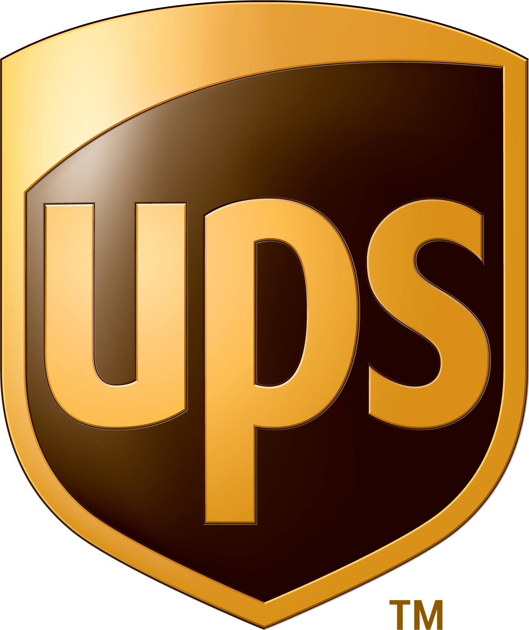
Shipping
UPS built a new open application platform for stability and availability
Gained high scalability and availability to support peak demand ²
² Red Hat UPS case study, May 2018.
Notes:
To support growing demand, pandemic or not, UPS stood up a new application platform to provide stability and availability. In addition to high availability they’ve achieved high scalability as well and it has served them through this sustained high demand period.
The company can now scale automatically as needed during peak demand times. The largest is obviously between Thanksgiving and the end of December—not just because of shopping but also returns. Open Shift has allowed them to scale flexibly during those particular peak times. Because of that, UPS can stay competitive by providing consistent, reliable package tracking and delivery services to customers — no matter the time of year.

Slide 61
Shipping
“As opposed to providing a solution in 18 months, we can start giving value back to the business within weeks or months.”
Carla Maier
Senior Manager, Cloud Platforms and Technology, UPS
Notes:
UPS, who needed a stable application platform to allow their business to run better, built that platform on an architectural foundation of Red Hat Enterprise Linux and Red Hat OpenShift Container Platform.
They were able to cut development cycle time from more than a year to months or weeks
They gained high scalability and availability to support peak holiday demand
And, they Improved collaboration between internal teams and external partners
Challenge
Create a new application platform to speed package delivery and give package facility operators mobile, real-time data access.
Solution
UPS built a new application environment with enterprise open source technology from Red Hat.
Why Red Hat
UPS chose Red Hat as a trusted cloud vendor after using Red Hat® Enterprise Linux® and Red Hat Fuse for more than 6 years.
Results
Cut development cycle time from more than a year to months or weeks
Gained high scalability and availability to support peak holiday demand
Improved collaboration between internal teams and external partners
Products and services
Red Hat OpenShift® Container Platform
Red Hat Enterprise Linux
Red Hat Fuse
Red Hat Consulting
Red Hat Training
Red Hat Technical Account Management
Source: Red Hat case study. “UPS streamlines package tracking and delivery with DevOps and Red Hat,” May 2018.

Slide 62
The public sector faces shifting legislative priorities, budget constraints, and legacy infrastructure, but stability is non-negotiable.
“Governments should evaluate legacy applications and
portfolios against modern capabilities to identify
potential areas to use new APIs and capabilities to
replace legacy features and functions.”¹
A UK government report found the country was likely to spend up to £22 billion maintaining support for obsolete systems.²
¹ Deloitte. “Tech Trends 2022: Peering through the lens of government,” 2021.
² Independent report. “Organising for digital delivery,” 22 July 2021.
Notes:
And remember the public sector challenges?

Slide 63

Public sector
The Government of Ireland’s Department of Agriculture, Food, and the Marine chose Red Hat OpenShift to mitigate risk of financial penalties and reputational damage from major breaches
Improved security and stability with enterprise technology and support ³
Significantly reduced breaches with intelligent, AI/ML text analysis solution³
³ Source: Red Hat DAFM Ireland case study. Apr. 2021.
Notes:
Budgets are always under scrutiny, and strategic imperatives change as governments do, but stability can never waver. The Government of Ireland’s Department of Agriculture, Food, and the Marine chose Red Hat OpenShift to mitigate the risk of financial penalties and reputational damages from major breaches.

Slide 64
Public sector
“The true value in Red Hat’s subscription is that in-depth product knowledge ... We can rely on Red Hat to help us bring the best possible projects to production in the safest, most stable way.”
Stephen Griffin
Architect and Software Development Manager, Version 1
Notes:
The Government of Ireland’s Department of Agriculture, Food, and the Marine (DAFM) processes grant applications submitted by farmers and their agents. However, incorrect document submissions by applicants led to data breaches in violation of the EU’s General Data Protection Regulation (GDPR). DAFM worked with Red Hat and Version 1 Software to create SmartText, a machine learning (ML) text analysis platform that scans documents and images for sensitive information and prevents unauthorized access. With a foundation built using Red Hat OpenShift and Red Hat 3scale API Management, DAFM can correctly categorize documents while protecting back-end systems and delivering new features faster.
Challenge
To mitigate the risk of financial penalties and reputational damage from major GDPR breaches, DAFM sought to replace its legacy data system and processes with an intelligent solution that would help correctly identify PSI and automate detection of breaches.
Solution
Worked with Red Hat partner Version 1 to outline requirements for an intelligent, automated approach to grant application processing. After evaluating several vendors, DAFM and Version 1 decided to use Red Hat® OpenShift®, supported by Red Hat 3scale API Management and Red Hat’s single sign-on (SSO) technology.
Why Red Hat
“Our research showed that we needed an enterprise Kubernetes platform to create our machine learning text analysis solution. Red Hat OpenShift was the clear leader in that market. Red Hat also provides the security and control we need as a government organization.” Gareth Sheerin, Enterprise Architect, Department of Agriculture, Food, and the Marine.
Results
Significantly reduced GDPR breaches with intelligent, AI/ML text analysis solution
Reduced development time from weeks to days with automation, APIs, and DevOps
Improved security and stability with enterprise technology and support
Products and services
Red Hat OpenShift
Red Hat 3scale API Management
Red Hat Consulting
Source: Red Hat DAFM Ireland case study. Apr. 2021.

Slide 65
The increased pressure on the healthcare industry, is forcing massive scale of digital systems.
“Patients are moving across the care continuum faster, and providers have a shorter window of time to deliver care right.”¹
“The pandemic was an accelerator of several trends, including shifting consumer preferences, rapidly evolving technologies…and clinical innovation.”²
¹ Wessinger, Dave, “The year of large-scale healthcare disruption: 2022 predictions,” Forbes. 23 Feb 2022.
² Deloitte Insights. “Digital transformation: From a buzzword to an imperative for health systems,” 26 Oct 2021.
Notes:
For healthcare organizations, scale has become more critical than ever.

Slide 66


Healthcare
Medife teamed up with Red Hat to transform its legacy infrastructure and paper-based processes.
Deliver services 92% faster
Processes 400% more invoices
Notes:
They need to deliver services faster, process patients quicker, and access data instantaneously.
Medife teamed up with Red Hat to transform its legacy infrastructure and paper-based products with Red Hat OpenShift. They now deliver services 92% faster, and process 400% more invoices

Slide 67
Healthcare
“During the pandemic, maintaining strong digital connections to associates in the healthcare sector is essential. Red Hat helped us achieve that connectivity to work more efficiently, no matter where our employees are located.”
Leonardo Lamas
CEO, Medifé
Notes:
By digitizing its customer experience, Medife improved its responsiveness and ability to meet patient demand.
Challenge
Needed to digitize its customer experience and improve its responsiveness by scaling their telemedicine operations and implementing smarter processes.
Solution
With Red Hat® technology and Red Hat Consulting, Medifé built an enterprise Kubernetes container foundation for microservices-based, cloud-native applications, including monitoring and authentication.
Why Red Hat
Red Hat was chosen because of its wealth of expertise in the healthcare sector and powerful open source technology.
Results
Cut delivery time for patient- and provider-friendly digital resources by 92%
Processed 400% more invoices with new core IT platform
Achieved 9 times greater telemedicine staffing and 100 times greater session availability to meet COVID-19 demand
Products and services
Red Hat OpenShift®
Red Hat Fuse
Red Hat Process Automation Manager
Red Hat Integration
Red Hat 3scale API Management
Red Hat Consulting
Source: Red Hat case study. “Medifé cuts delivery time for crucial healthcare services by 92% with Red Hat,” Mar 2021.

Slide 68
Data, the “new fuel” of the automotive industry, is forcing massive scale of digital systems ¹
Auto manufacturers are becoming IoT platform and device companies
Real-time data analysis through AI/ML is key to successful autonomous driving systems
¹ Meola, Andrew. “How 5G and IoT are driving the connected smart vehicle industry.” Business Insider, March 2020.
Notes:
And finally, let’s revisit those automotive industry challenges.

Slide 69


Automotive
The BMW Group ConnectedDrive platform scaled as the data scaled
12 million connected cars
1 billion requests per week
² Red Hat Summit 2019 keynote, 9 May 2019;
³ Red Hat Forum DACH, 14 Jan. 2020.
Notes:
BMW needed speed, stability and scale in order to support a future of connected cars and autonomous driving, so they turned to Red Hat for the stack of technologies that made the ConnectedDrive platform possible.

Slide 70
Automotive
“We can localize clusters in different markets if we need to and therefore serve our customers on a worldwide scale.”
Dr. Alexander Lenk
Lead Architect Connected Vehicle, Digital Backend,
Big Data, Blockchain
BMW Group
Notes:
In 2019, they were handling 1 billion requests per week from 12 million connected cars. With an anticipated 30 per cent growth per year, clearly this was not going to be something they could tackle with traditional IT. They migrated their back end completely to the Open Shift platform, which they knew would give them the scalability and resilience they need to serve their customers around the world.

Slide 71



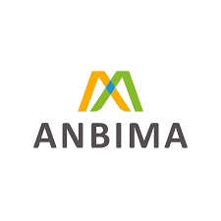
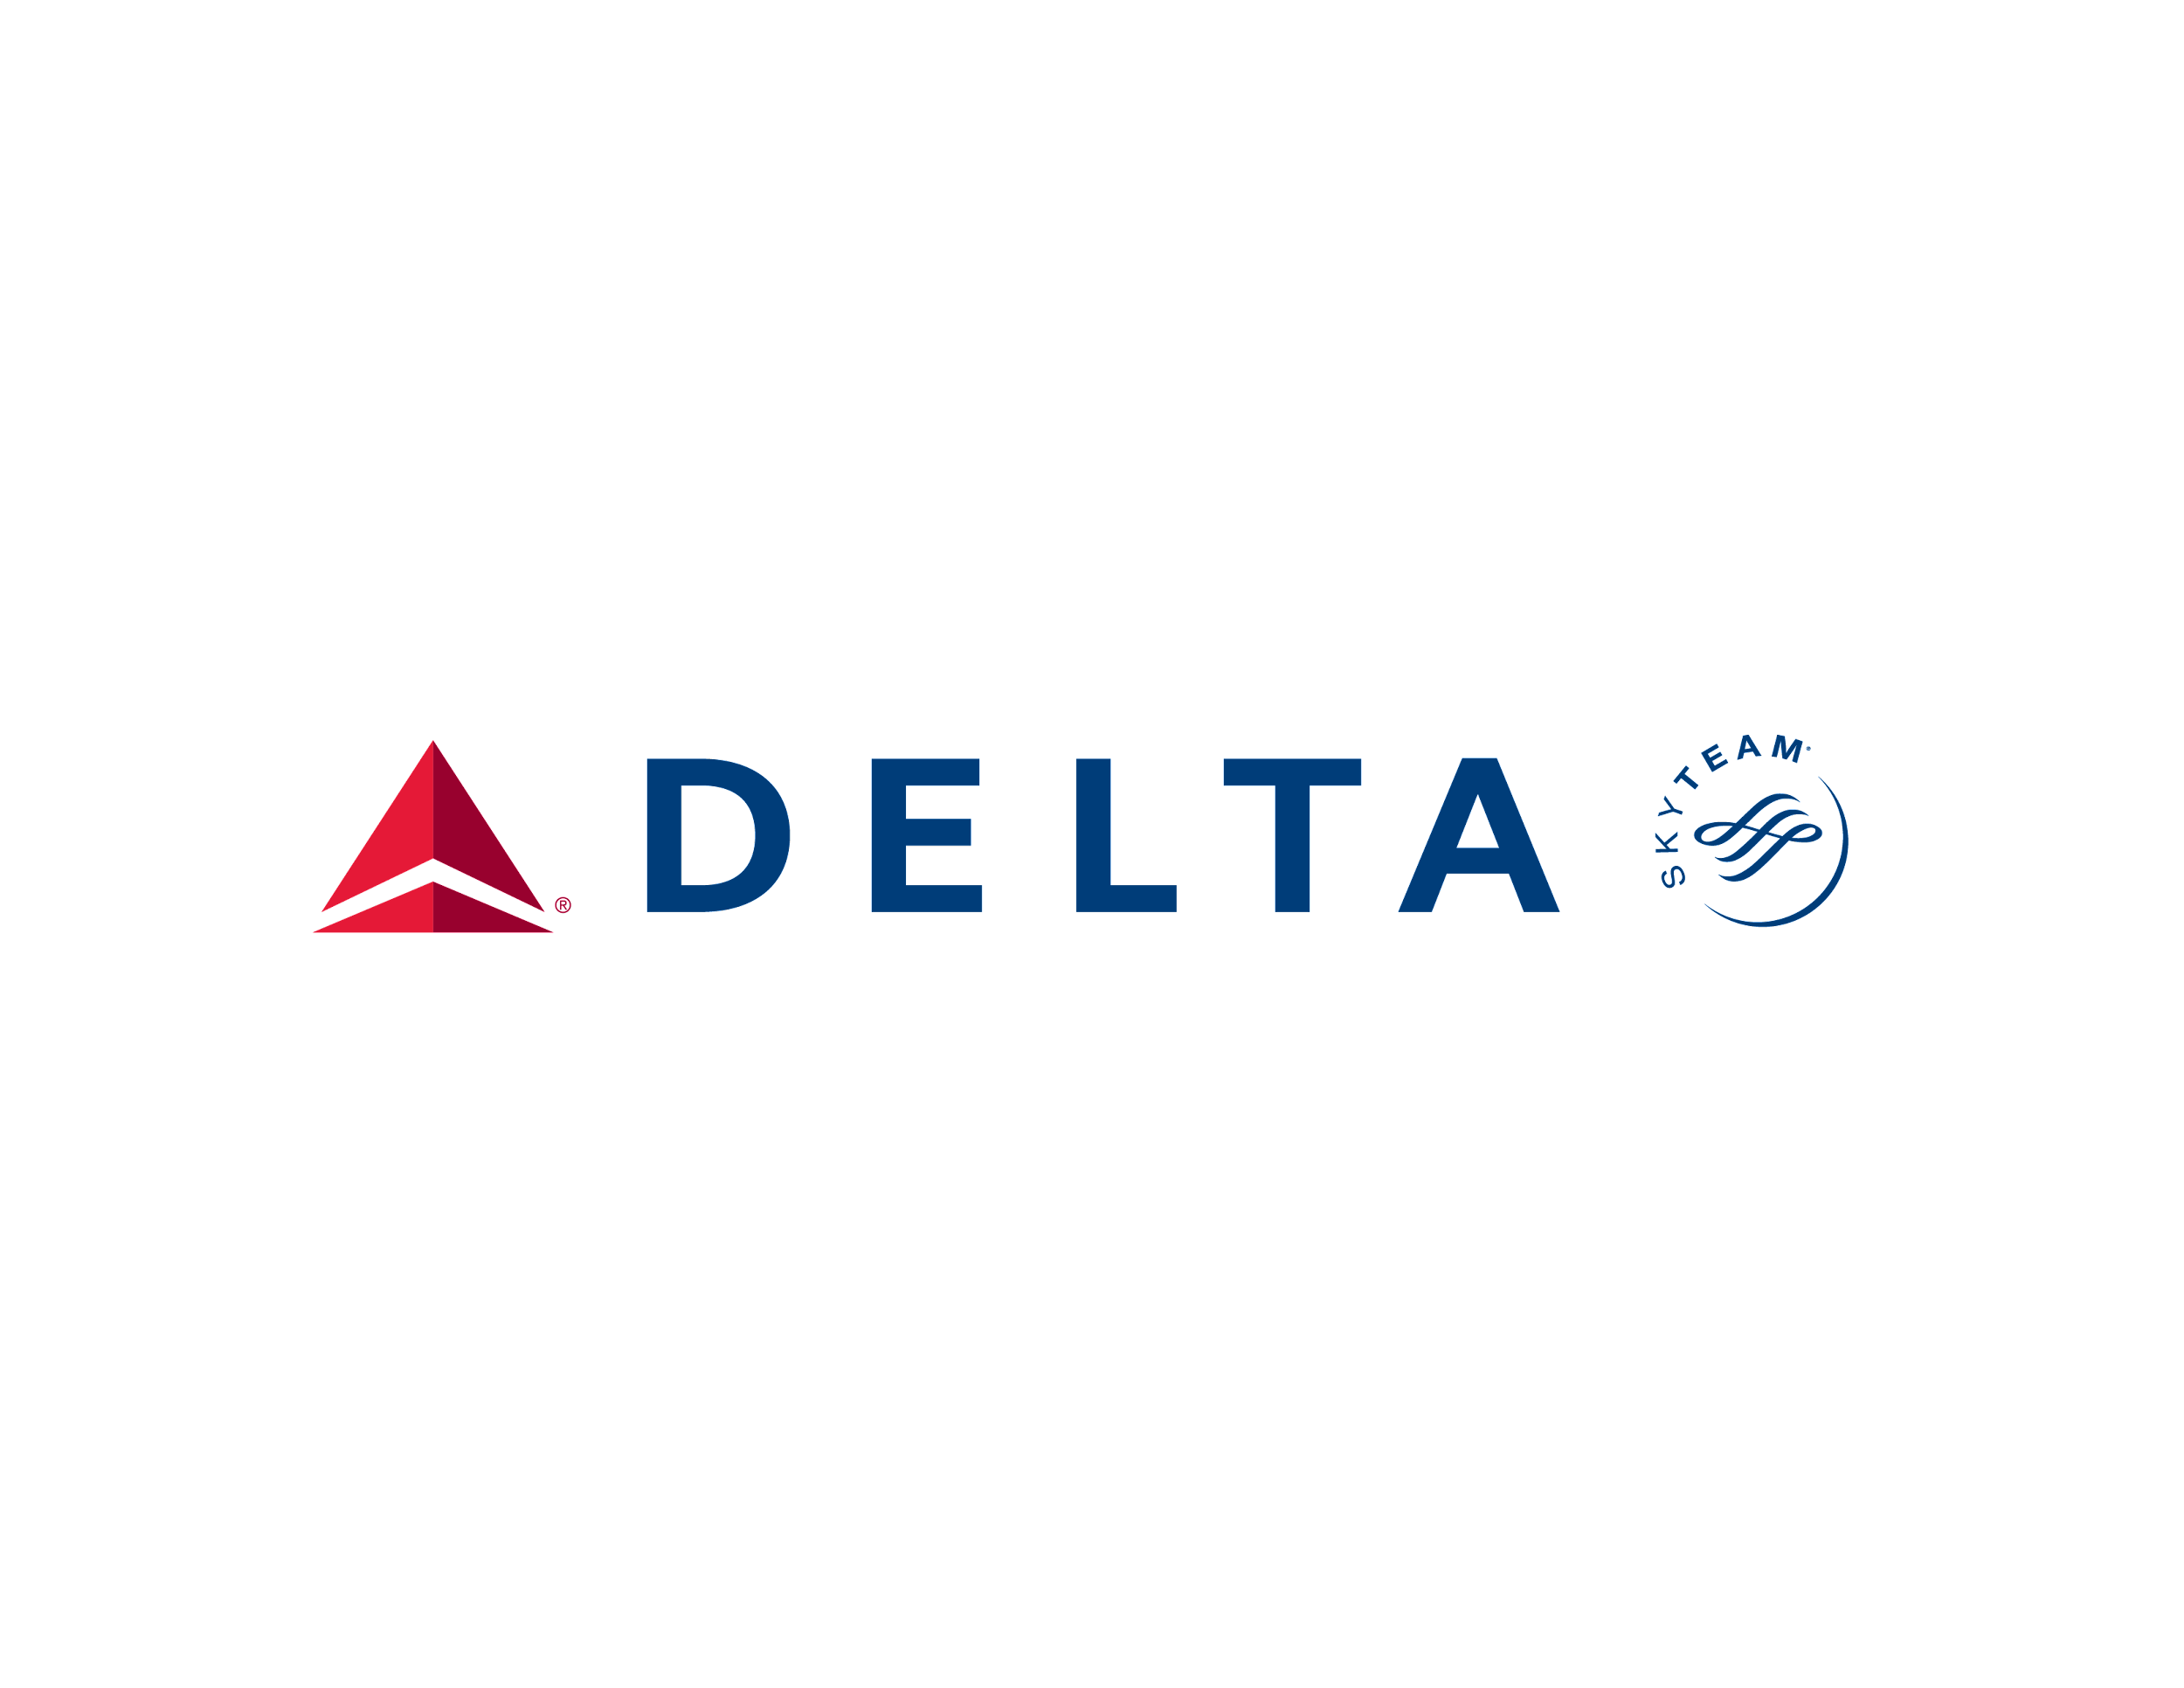













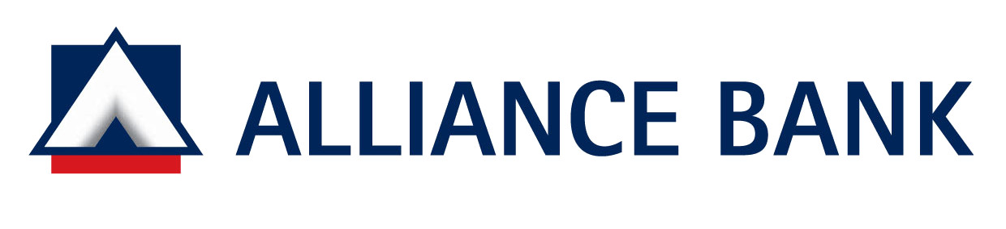
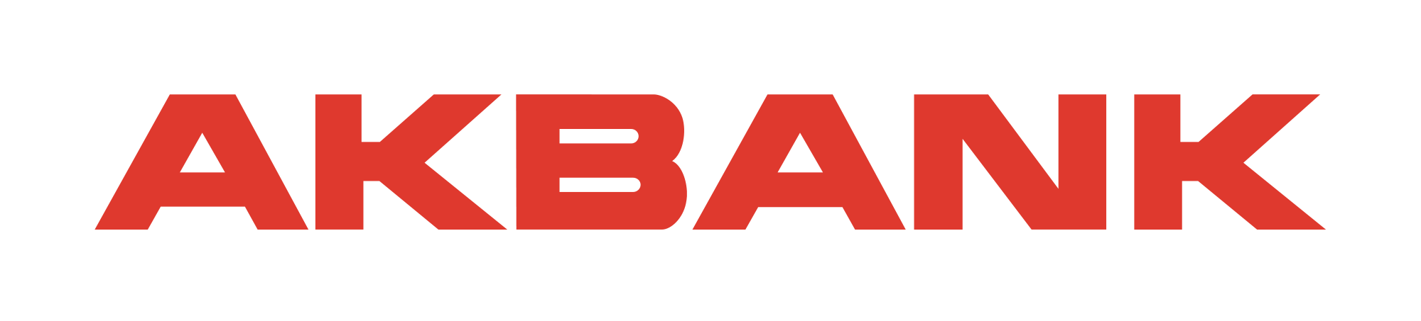


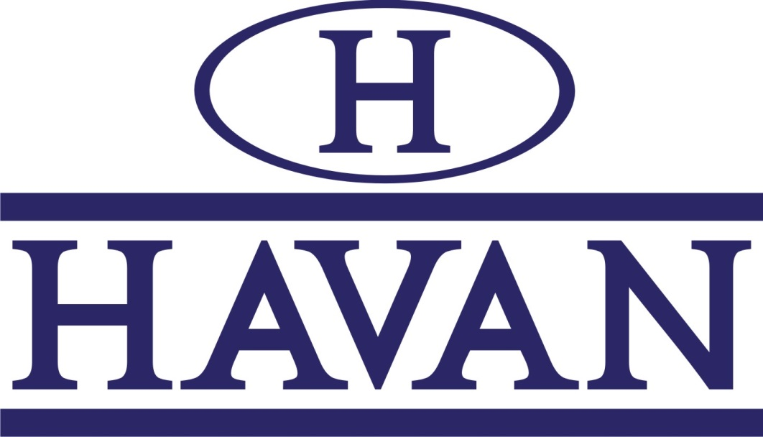

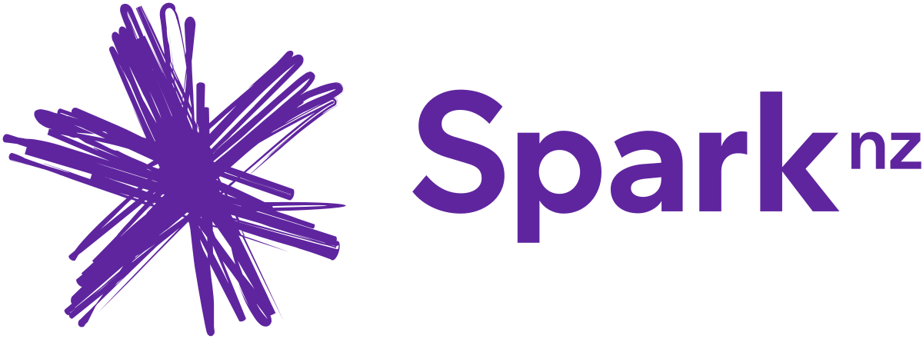


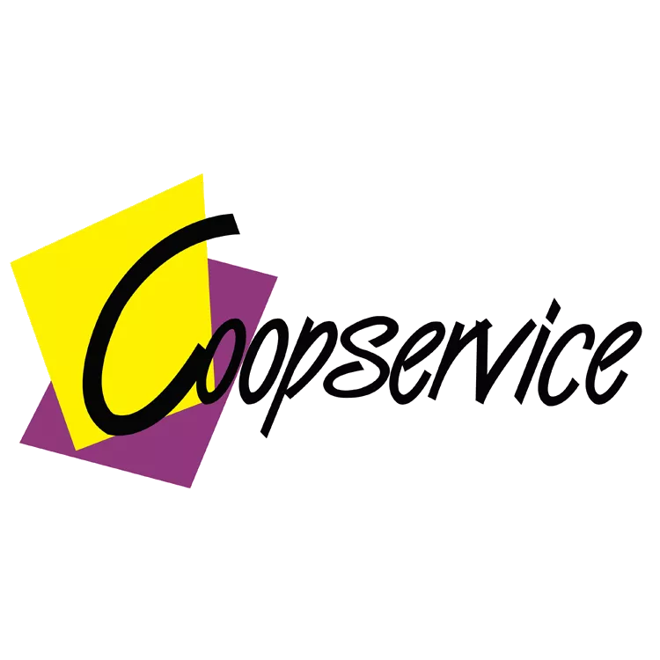
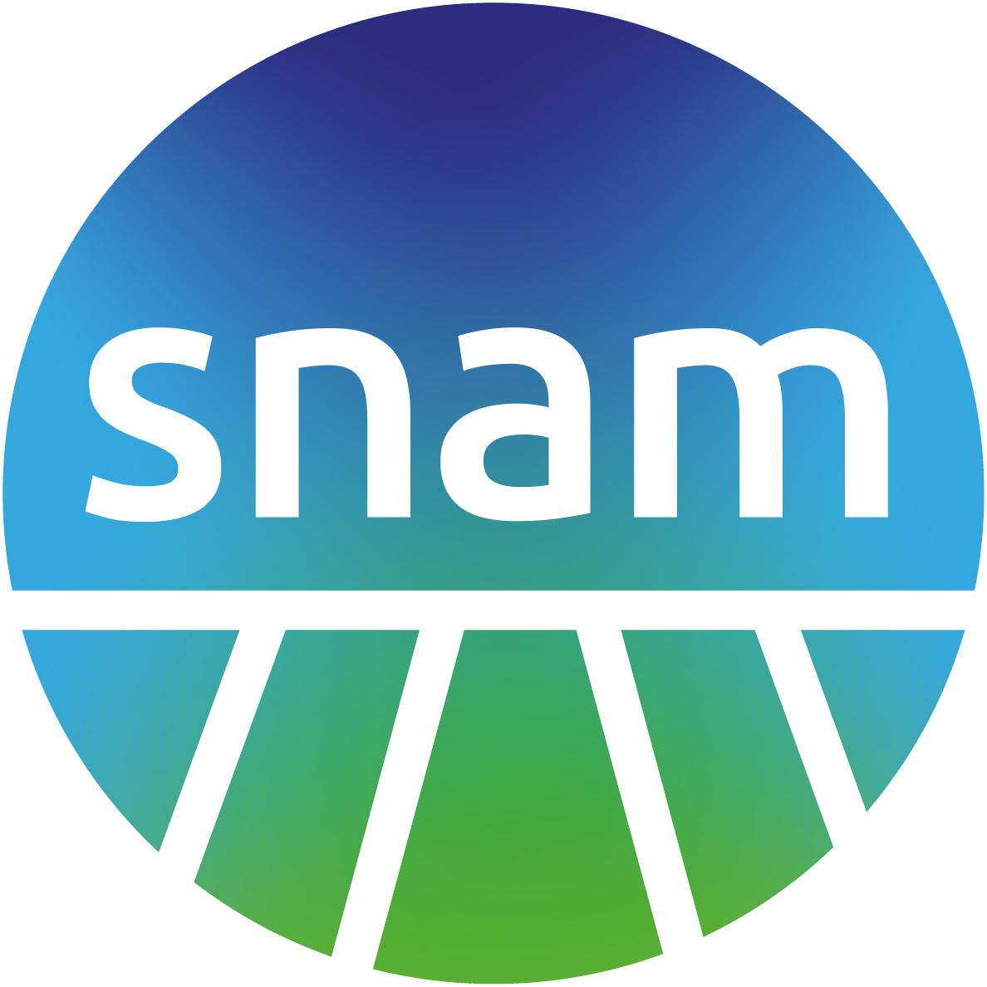



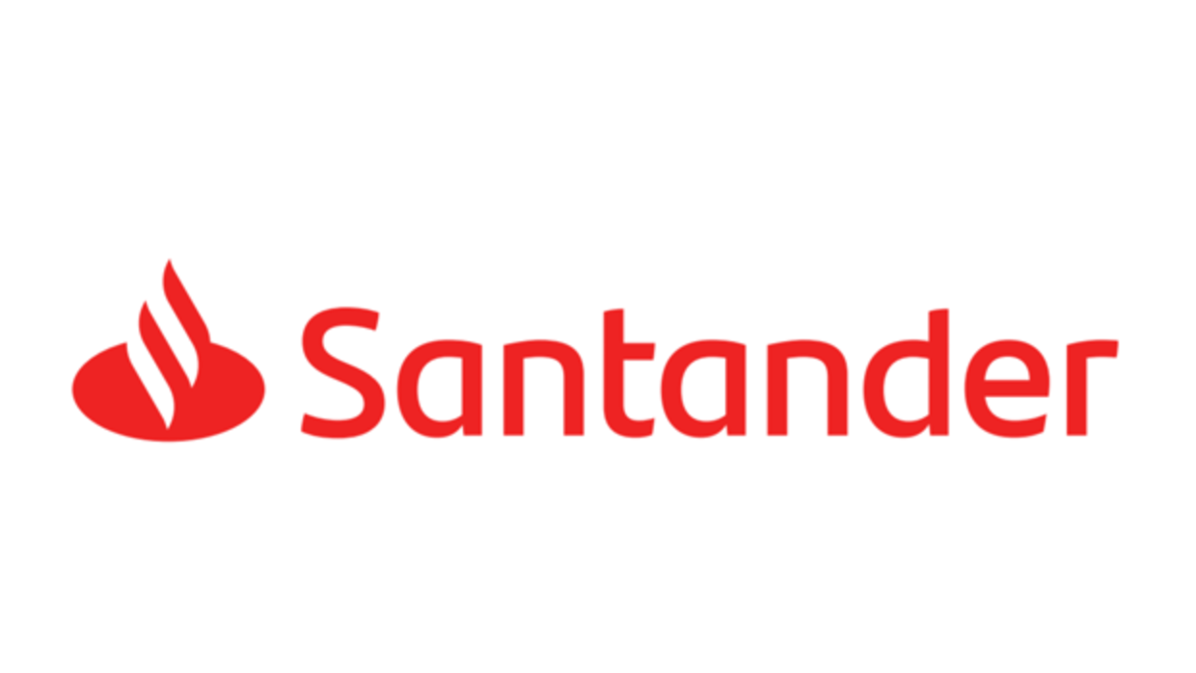






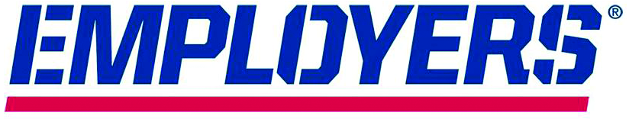






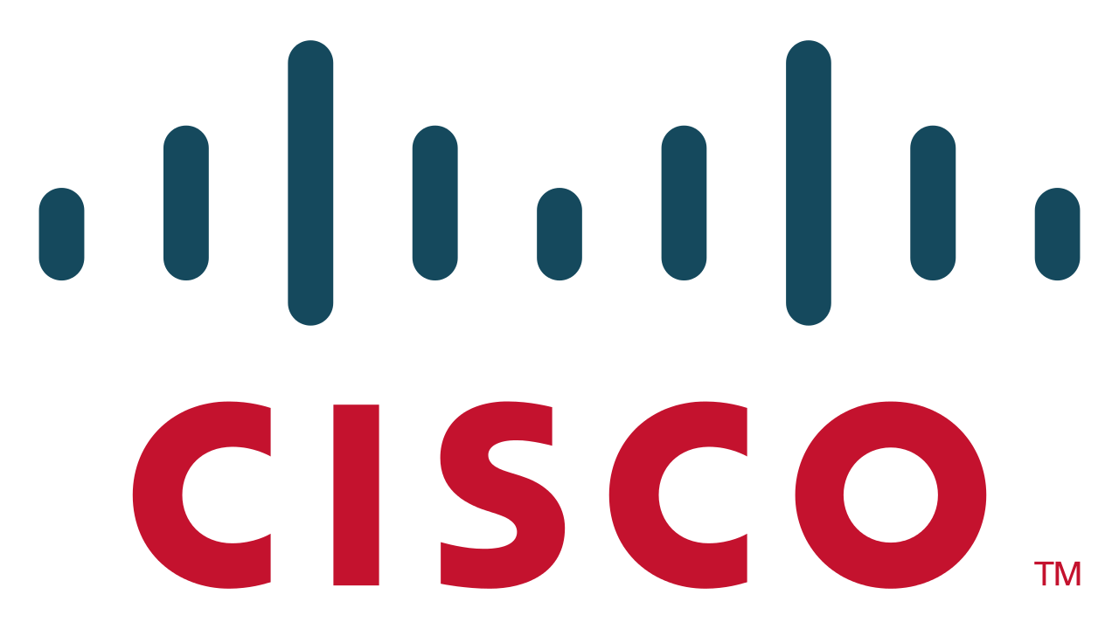

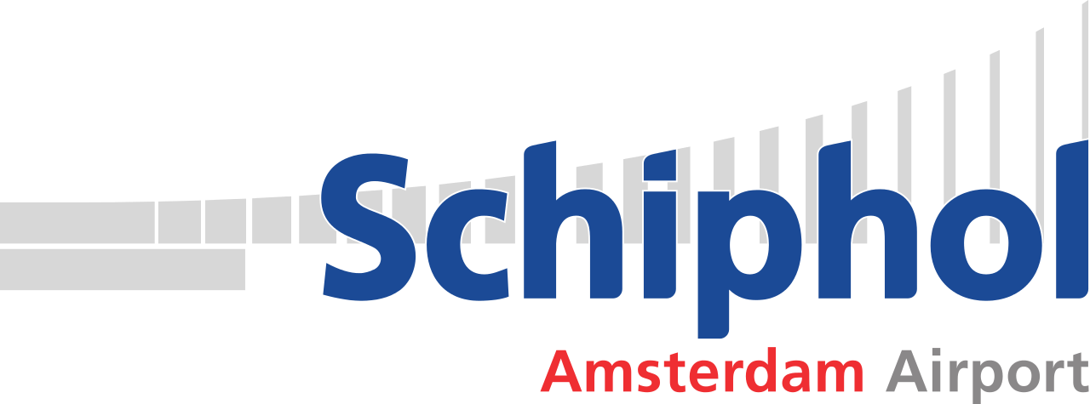

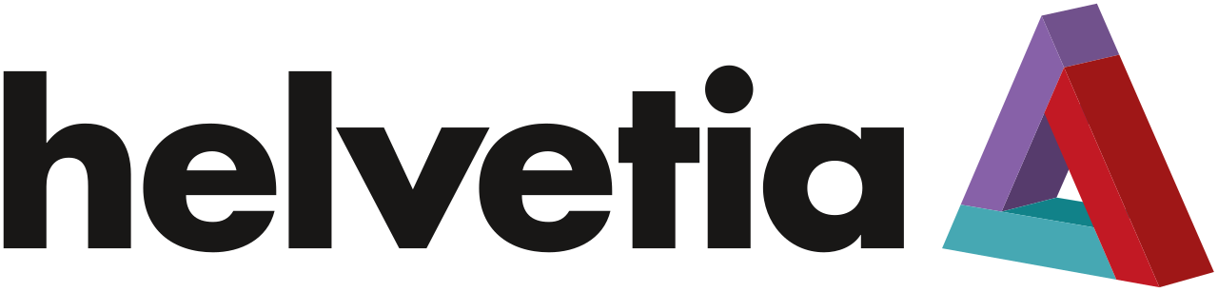


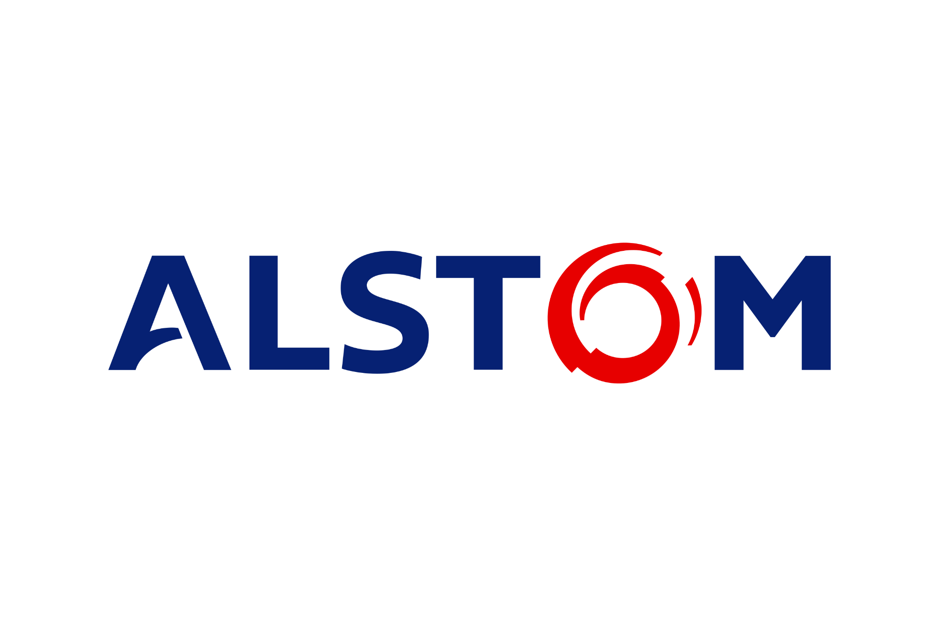
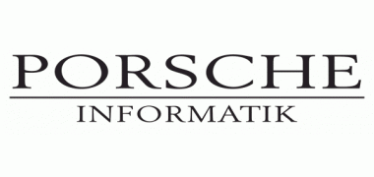
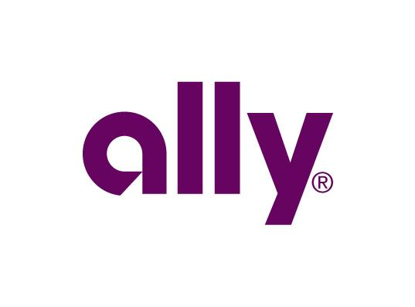
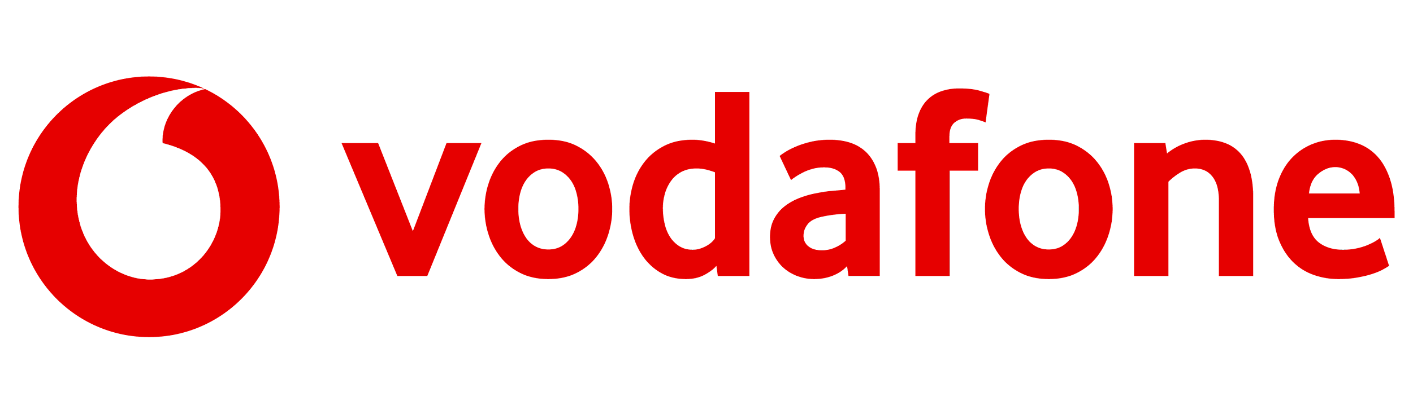


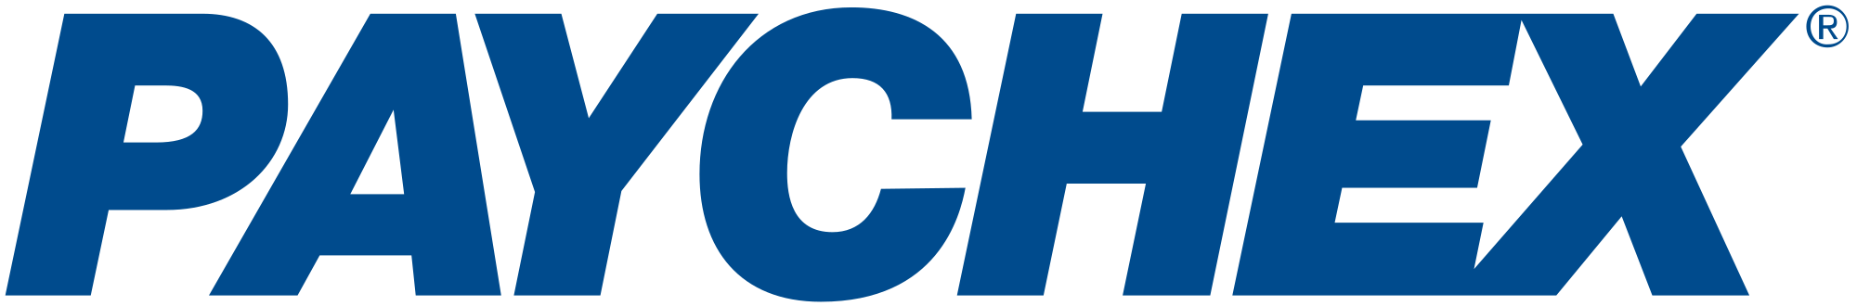





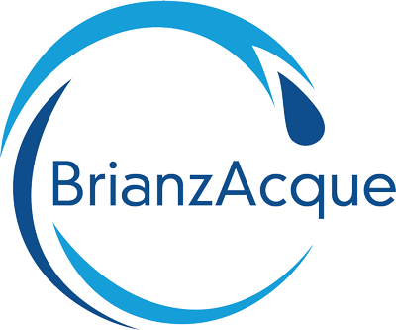





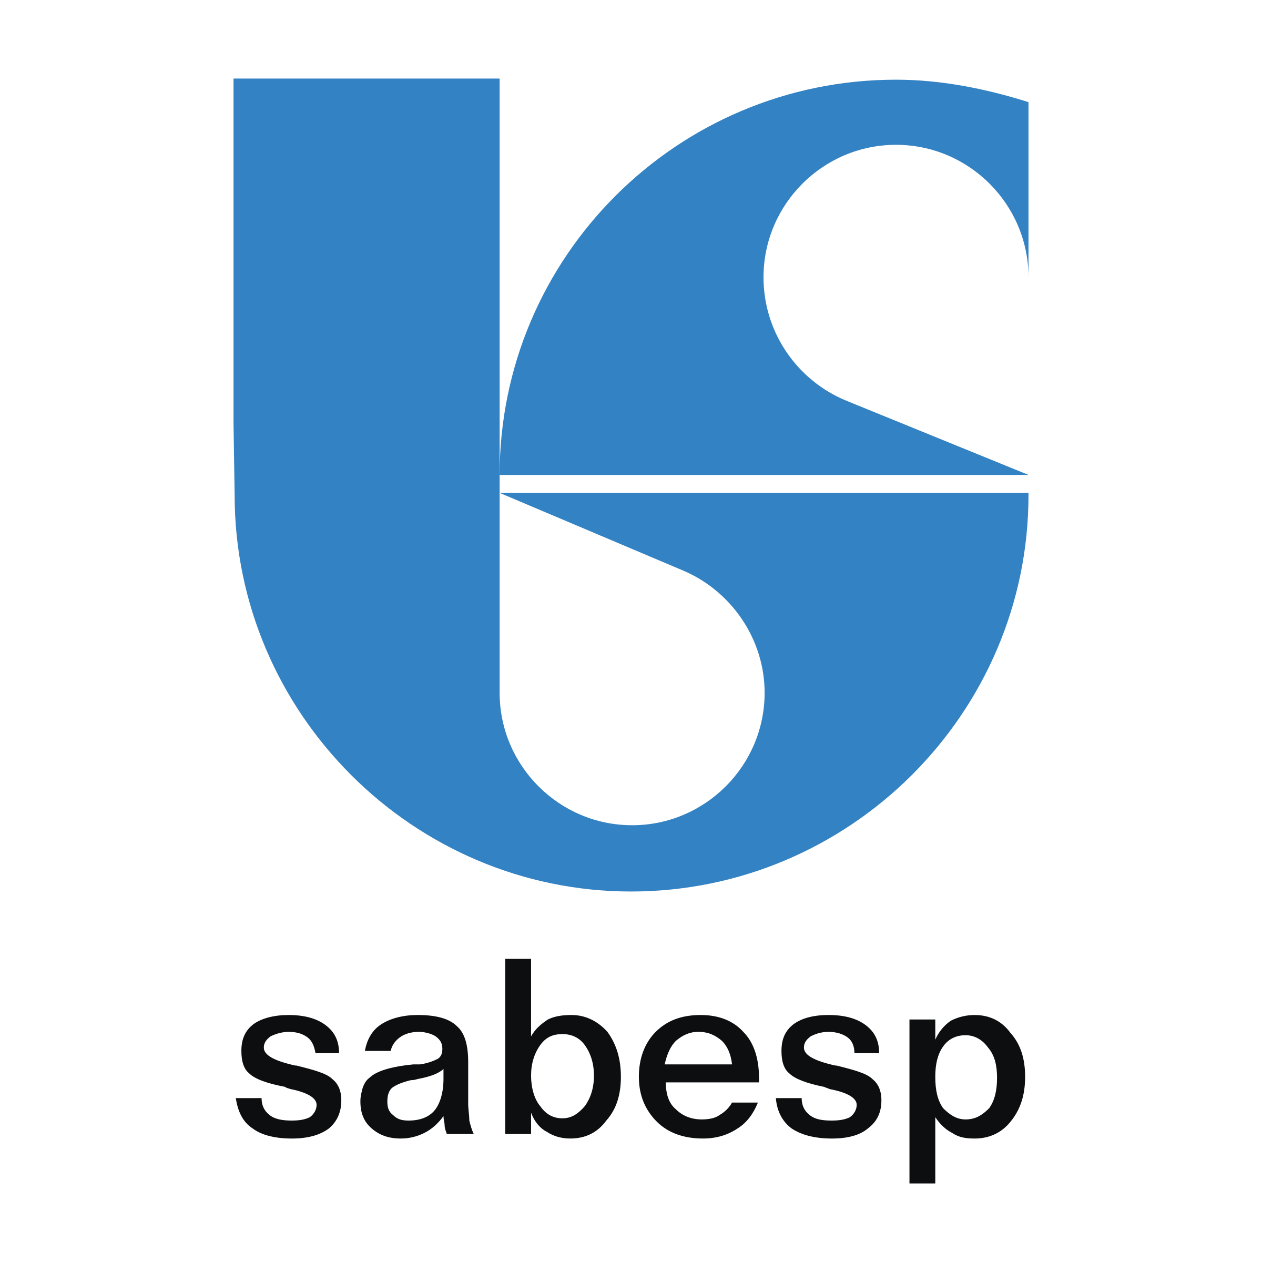
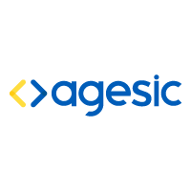




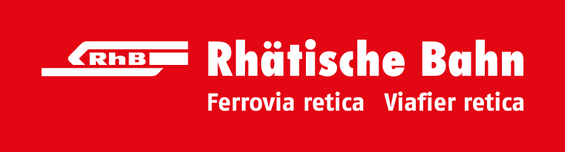




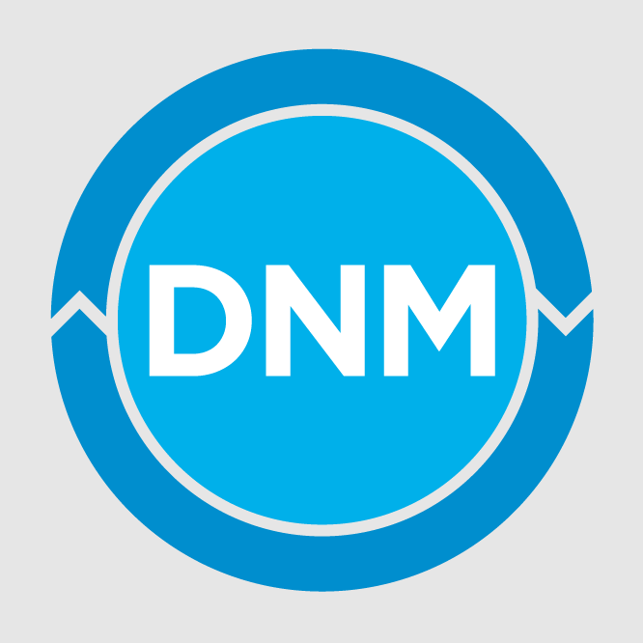


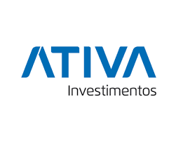




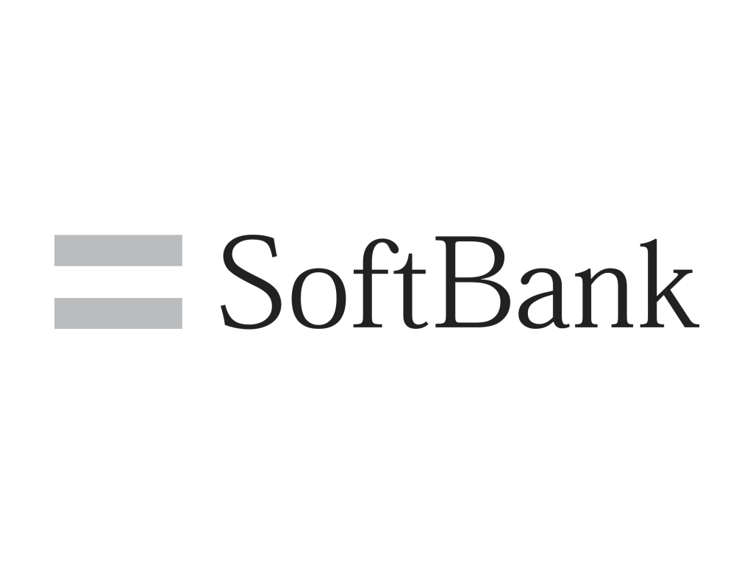

































Publicly Referenceable Red Hat OpenShift Customers
Notes:
Those are just three of OpenShift’s thousands of customers around the globe with similar stories to tell.
And they’re telling the same stories that the analysts are uncovering. For example..
[[Link to OpenShift customers: https://docs.google.com/spreadsheets/d/10BlqkMSrU_E8iWIJbR8ONc6mq7rPPod4ekAYb8hygeg/edit?usp=sharing ]]

Slide 72
[[Choose between the next two slides - which stats will resonate most with your customer?]]

Slide 73






Delivering innovation that can transform your business
100x
5x
Cost reduction for
operating infrastructure
Faster revenue growth attributed to enabling developer velocity
Automated, full stack installation
Seamless Kubernetes deployments
Auto-scaling of resources
One-click life-cycle management
Source:
McKinsey & Company. “Driving business outcomes through Developer Velocity,” March, 2020 and “Developer Velocity: How software excellence fuels business performance.” April, 2020.
Notes:
Here’s what McKinsey and Company discovered….

Slide 74


Delivering innovation that can transform your business
40%
70%
Increase in sales over 3 years with new revenue streams¹
Infrastructure cost reduction for AI workloads²
Automated, full stack installation
Seamless Kubernetes deployments
Auto-scaling of resources
One-click life-cycle management
Source:
1 - Employers centralizes insurance apps on Red Hat OpenShift, March 2021
2 - Turkcell supports AI-powered innovation with Red Hat OpenShift, August 2021
Notes:
Here are some of the business impacts that our customers have seen with Red Hat OpenShift. Optimizing your strategy around innovation at speed for developers can transform your business, regardless of where your applications are deployed.

Slide 75







Realizing business value from a hybrid strategy
636%
20%
return on investment over 5 years
higher application developer productivity
10 months
US$21.6 million
to payback
higher revenue per year per organization
54%
71%
lower 5-year cost of operations
less unplanned downtime
3x
21%
more new features per year
more efficient IT infrastructure teams
Source:
IDC White Paper, sponsored by Red Hat, "The Business Value of Red Hat OpenShift", doc # US47539121, February 2021.
Notes:
And IDC: Research has shown incredible business and IT benefits for customers that have adopted OpenShift.
In a study performed by IDC, OpenShift customers have seen on average 661% ROI and an investment payback in just 5 months.
And you can see these other numbers that show the impact on the business and IT.

Slide 76









Red Hat OpenShift
Container platform market share leader
15%
Mirantis
3.9%
Rancher Labs
47.8%
Red Hat OpenShift
7.7%
VMware
24.4%
Other
1.2%
Canonical
Source: Who’s Winning in the Container Software Market, IT Pro Today, Jun 29, 2021.
Notes:
And in terms of industry leadership, we’re ahead of the pack - exactly where you want your business to be.

Slide 77

The world’s leading provider of open source enterprise IT solutions
80%
61%
of Fortune Global 500 commercial banks
of Fortune Global 500 services companies
100%
80%
of Fortune Global 500 telecom companies
of Fortune Global 500 government and military companies
More than 64%
80%
of the top 25 companies on the Global 500 list use Red Hat OpenShift
of Fortune Global 500 media and technology companies
Source:
Fortune Global 500 subscription data as of 20 January 2021
Notes:
Global companies trust us because we are the world's No. 1 provider of commercial IT products and solutions based on open source software. And we lead by a large margin.
And more than 90% of the Fortune 500 use Red Hat products and solution, which shows that we’ve got a vast reach, around the world, and in a range of industries.
[Data published Jul 2021, and years previous. See the corporate awareness campaign Source page for more info.]
With approximately 19,500 employees in more than 40 countries, we have a worldwide presence. The point to emphasize is that Red Hat has the size, scale, and capacity to meet customer needs. We have a global presence and can support our customers and partners wherever they are.
Additional points to make:
Red Hat is a large-scale innovator of open source technologies. While we collaborate with open source communities, partners, and customers, we also do a lot of pure development to ensure that our products are suitable for enterprise-wide, critical deployments.

Slide 78
The world’s leading provider of open source enterprise IT solutions
80%
of Fortune Global 500 commercial banks
61%
of Fortune Global 500 services companies
100%
of Fortune Global 500 government and military companies
80%
of Fortune Global 500 telecom companies
More than 64%
80%
of Fortune Global 500 media and technology companies
of the top 25 companies on the Global 500 list use Red Hat OpenShift
Source:
Fortune Global 500 subscription data as of 20 January 2021
Notes:
Global companies trust us because we are the world's No. 1 provider of commercial IT products and solutions based on open source software. And we lead by a large margin.
And more than 90% of the Fortune 500 use Red Hat products and solution, which shows that we’ve got a vast reach, around the world, and in a range of industries.
[Data published Jul 2021, and years previous. See the corporate awareness campaign Source page for more info.]
With approximately 19,500 employees in more than 40 countries, we have a worldwide presence. The point to emphasize is that Red Hat has the size, scale, and capacity to meet customer needs. We have a global presence and can support our customers and partners wherever they are.
Additional points to make:
Red Hat is a large-scale innovator of open source technologies. While we collaborate with open source communities, partners, and customers, we also do a lot of pure development to ensure that our products are suitable for enterprise-wide, critical deployments.

Slide 79

Red Hat OpenShift is the platform built for cloud native application development and deployment across the hybrid cloud
Notes:
Red Hat OpenShift is simply the platform built for cloud native application development and deployment across the hybrid cloud

Slide 80


Red Hat OpenShift is for every innovator
Ready for IT operators
Automate processes. Reduce complexity.
Operate more securely from end to end
Empowering developers
Code fast with familiar tools.
Rapidly deliver without roadblocks.
Proven for business leaders
Choose a platform to power business today.
Create a cloud strategy for the future.
Notes:
OpenShift is built for operators, developers and business leaders alike.
IT Operations leaders tend to focus application modernization efforts. Setting the organization up for success, often through digital transformation efforts, while keeping today’s infrastructure running efficiently and securely. OpenShift’s automated processes and single platform for deployment, management and Day 2 operations, simplifies operations and increases operational efficiency.
OpenShift is also committed to empowering developers with the integration of the familiar tools that they are used to using. We simplify the development process and removing roadblocks providing a reduction in wait times, increasing overall developer productivity and supporting a “cloud-first” mentality.
And finally, for business leaders across the organization, OpenShift empowers the dev and IT teams focus on innovation and drive business differentiating experiences that can not only grow the bottom line, but improve both customer and employee experiences.

Slide 81
Where does your organization want to go next?
Notes:
So, what is happening in your world? And where do you want to go next?

Slide 82

How are you planning on tackling your concerns about speed?
Notes:
So, what is happening in your world? And where do you want to go next?

Slide 83

How are you planning on tackling your concerns about stability?
Notes:
So, what is happening in your world? And where do you want to go next?

Slide 84

How are you planning on tackling your concerns about scale?
Notes:
So, what is happening in your world? And where do you want to go next?

Slide 85

How are you planning on tackling your concerns about security?
Notes:
So, what is happening in your world? And where do you want to go next?

Slide 86

How can we help you get to where you want to go?
Notes:
So, what is happening in your world? And where do you want to go next?

Slide 87

What can we tell you more about?
Notes:
So, what is happening in your world? And where do you want to go next?

Slide 88




Thank you
linkedin.com/company/red-hat
youtube.com/user/RedHatVideos
Red Hat is the world’s leading provider of enterprise open source software solutions. Award-winning support, training, and consulting services make
Red Hat a trusted adviser to the Fortune 500.
facebook.com/redhatinc
twitter.com/RedHat
Notes:
Thank you and discussion

Slide 89
APPENDICES

Slide 90


















Why customers choose Red Hat OpenShift
Digital Transformation & Innovation with Containers
Trusted enterprise Kubernetes
Cloud-like experience everywhere
Empowering developers to innovate
Open source innovation
Notes:
The guiding principles behind OpenShift can be categorized into four areas:
Innovation is happening in Open Source communities, and Red Hat is the best positioned company to help contribute and grow those community, as well as bring the value of that innovation to customers.
While customers have demands to run applications in many clouds, they also want to reduce the amount of operational complexity that comes from multi-cloud strategy. OpenShift enables customers to have a consistent development and operational experience across any combination of clouds (public and private).
As we’ve learned over the years, there is no single profile of a developer or the way that developers want to get applications into production. So OpenShift is flexible to enable many ways to empower developers and allow many types of applications on the platform.

Slide 91

Why Customers Choose OpenShift
Leadership in Kubernetes market, customer adoption & in the community
Comprehensive platform from Linux, to Kubernetes infra, to devops tools
Fully managed cloud services, providing full stack mgt from Kubernetes experts
Consistency across all public cloud, datacenter and edge environments

Slide 92





Creating value depends on your ability to deliver applications faster
Digital Transformation & Innovation with Containers
Cloud-native applications
AI & machine learning
Analytics
Internet of Things
Innovation culture
Containers, Kubernetes, and hybrid cloud are key ingredients.
OpenShift is the best platform to deliver container-based applications.
Notes:
What we hear from customers around the world is that their ability to create value for their end customers, both internal and external, depends on your ability to deliver applications faster.
It’s really your ability to be great at application development and app delivery to differentiate your business, engage customers, and find new ways to create value that could turn into revenue opportunities.
For example, the CEO of Volkswagen says that there are now more than 10 Million lines of code going into the average car, probably more than what’s in your smart phone.
Best Buy uses a combination of customer-facing mobile apps, brick-and-mortar and services strategies to thrive in the face of Amazon.
And even GE Digital has adopted what they call Kubernetes-as-a-service to enable developers to innovate across their organization.
Containers and Kubernetes fundamentally enable DevOps, microservices and cloud-native application development, and we’d like to think that OpenShift is the best platform to deliver applications across the hybrid cloud.

Slide 93
Building a Platform is not YOUR business focus
Service Mesh
App-Services
DB-Services
OpenShift allows your technology teams to focus on building business value, not focusing on building technology platforms
xKS services are NOT free, and not simple
CI/CD
DNS
Authentication
Monitoring
xKS Service
Automation
Logging
Registry
Security
Compute
Storage
Network
xKS Services are Kubernetes Cloud lock-in
10-20+ individual services needed to make a platform
Customer must do integrations and maintenance
All non-xKS Services priced differently
All non-xKS Services supported individually
Additional costs and
integrations
Notes:
xKS Services are NOT free, and not Simple

